Slide 1
Transformation using SSIS
Vraj Suratwala
Department of ICT, VNSGU

Slide 2
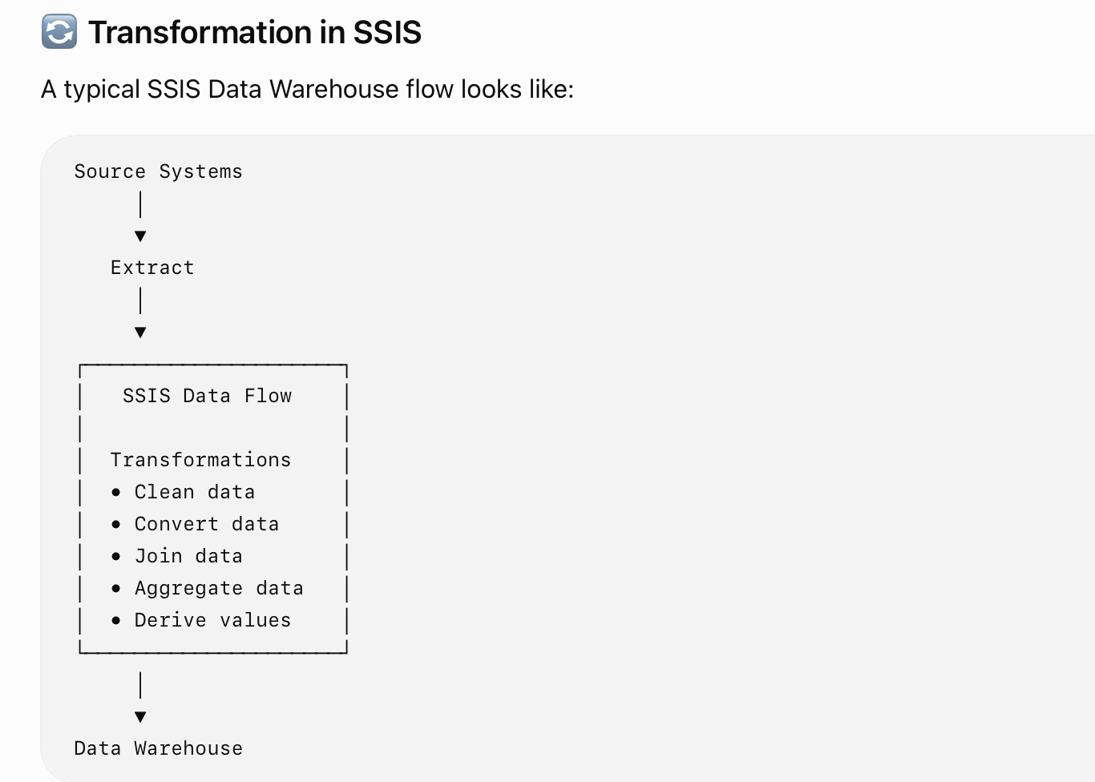
Introduction
SSIS (SQL Server Integration Services) is a Microsoft tool used to perform ETL — Extract, Transform, Load operations.
In SSIS, Transformation means changing, cleaning, converting, combining, or enriching data after it is extracted from the source and before it is loaded into the Data Warehouse.

Slide 3
Important Transformation
1. Data Conversion
2. Derived Column
3. Conditional Split
4. Lookup
5. Merge
6. Merge Join
7. Aggregate
8. Sort
9.Row Count
10. Data Cleaning Transformation

Slide 4
Copy Column Transformation
Copy Column Transformation is an SSIS transformation used to create a copy of an existing column in the data flow.
The original column remains unchanged, while a new column containing the same values is created.
SIMPLE DEFINITION :
Copy Column Transformation copies the contents of an existing input column into a new output column.n

Slide 5
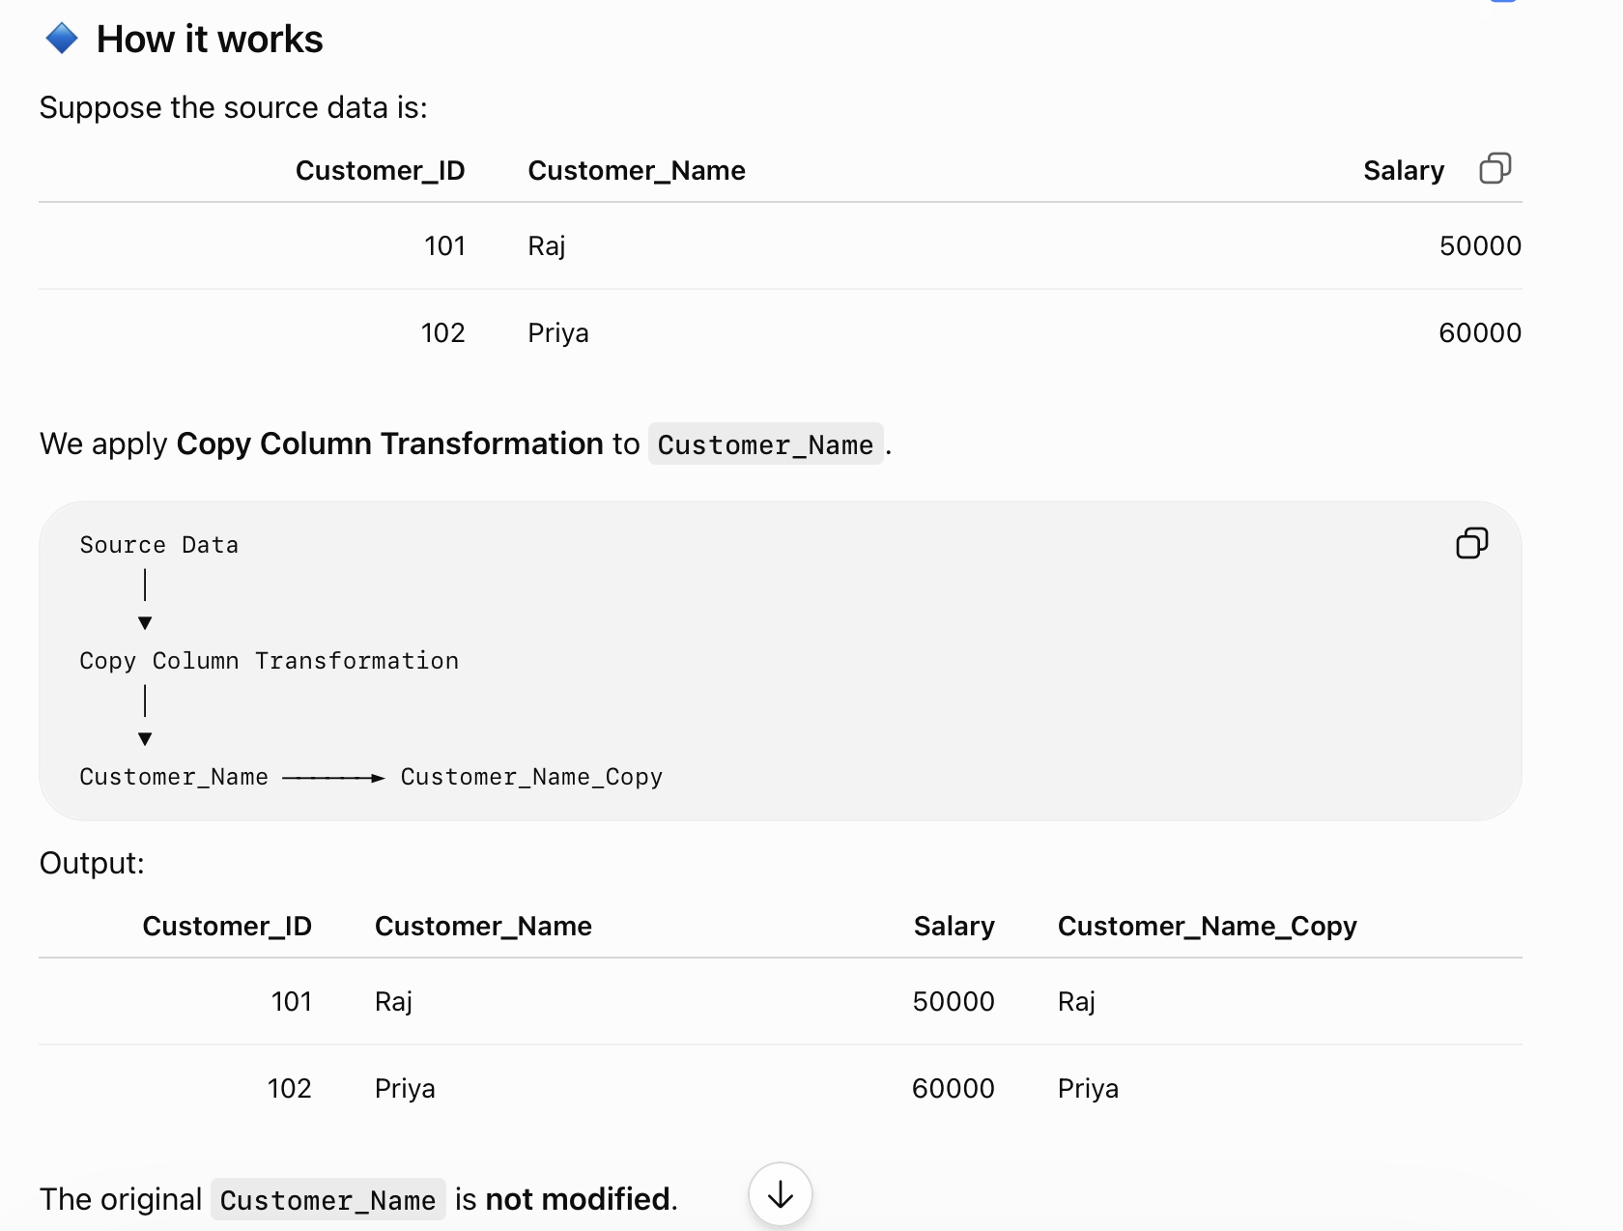

Slide 6
Usage
Keep the original value for reference.
Create a duplicate column for further processing.
Preserve source data before applying another transformation.
Use the copied column for comparison or validation.

Slide 7
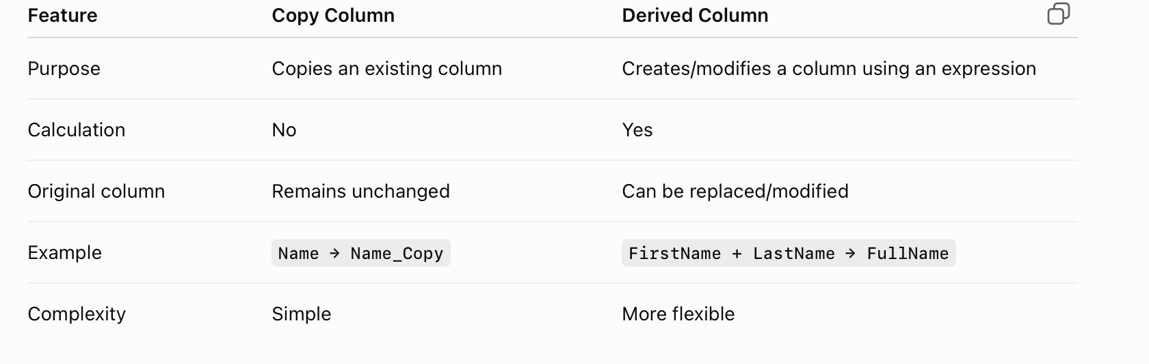
Comparision

Slide 8
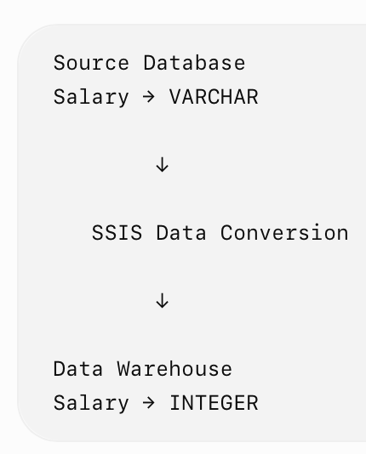
Data Conversion Transformation in SSIS
Data Conversion Transformation in SSIS is used to change the data type of a column from one data type to another
Data Conversion Transformation converts the data type of input columns into another compatible data type required by the destination.
NEED :
Different systems may store the same type of data using different data types.
If the destination expects an INT but the source provides a VARCHAR, we need Data Conversion Transformation.

Slide 9
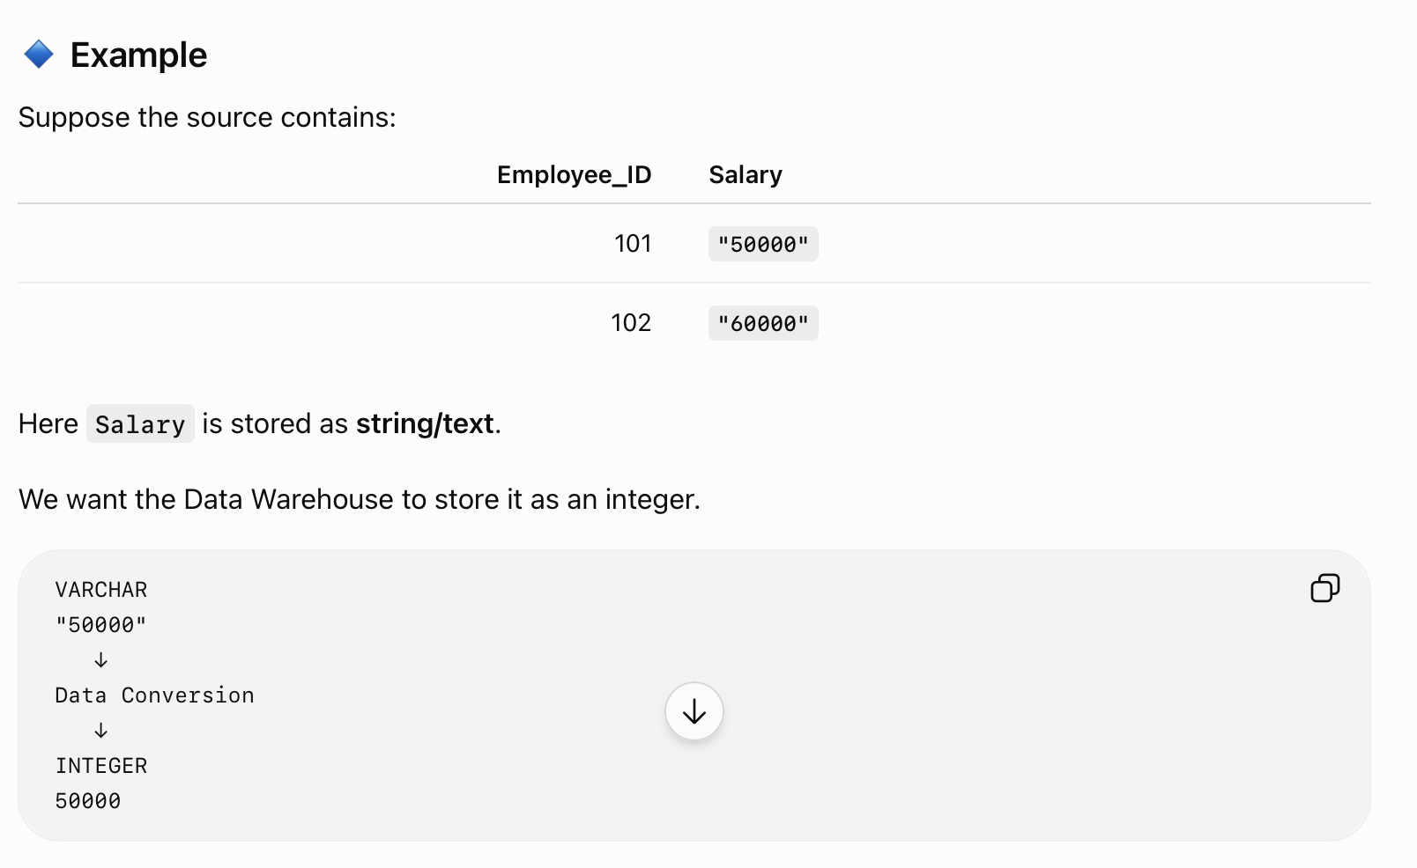
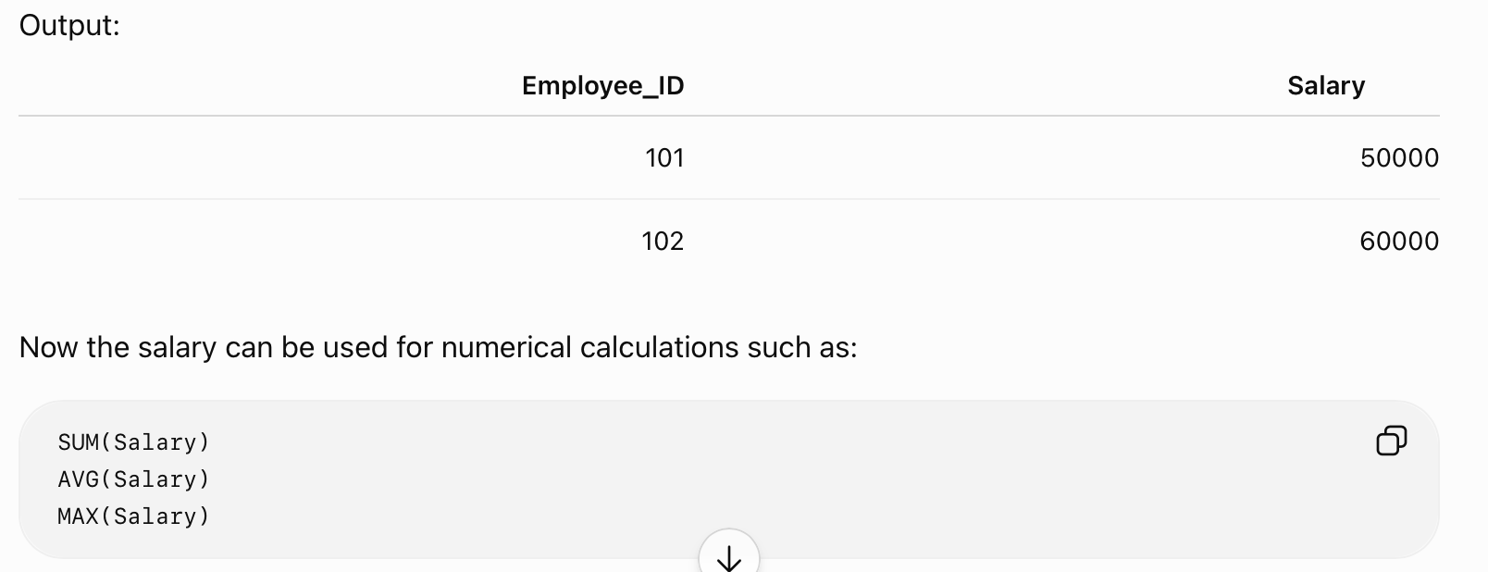
Example

Slide 10
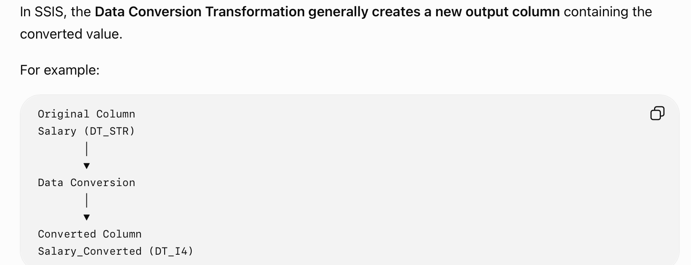
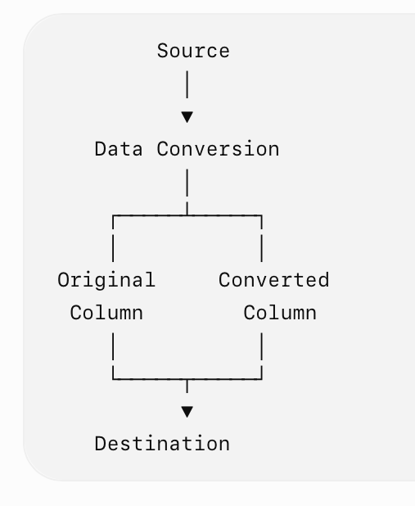
IMP Point

Slide 11
Control Flow & Data Flow
BI

Slide 12
Control Flow
Control Flow in SQL Server Integration Services (SSIS) defines the sequence and conditions in which tasks are executed within an SSIS package.
In simple words:
Control Flow = Decides what to do, when to do it, and under what condition.
It consists mainly of Tasks, Containers, and Precedence Constraints.

Slide 13
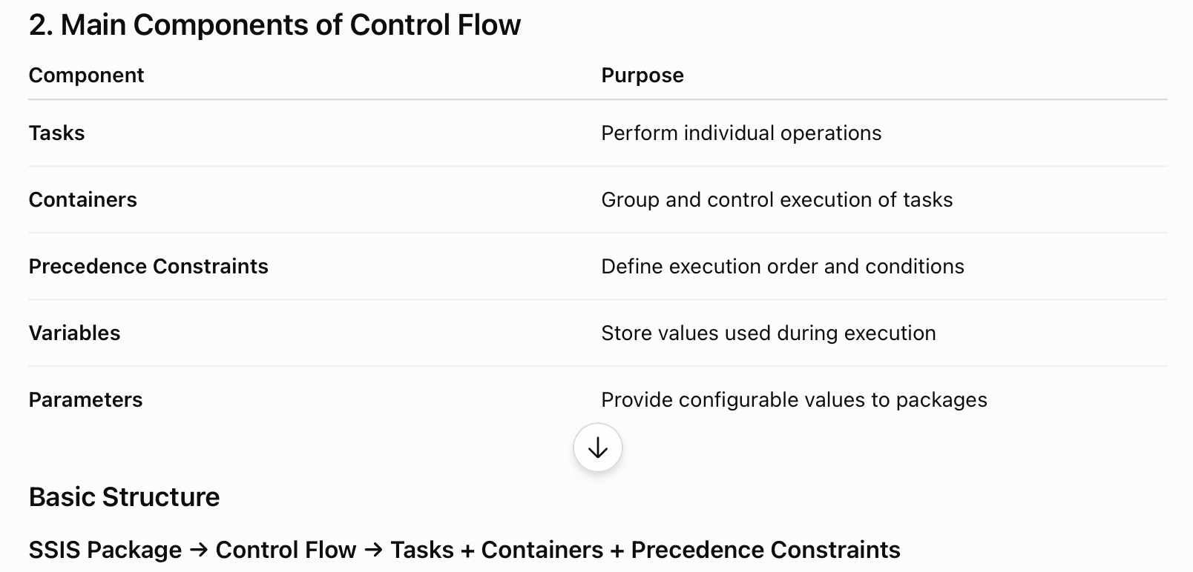
Main Component

Slide 14
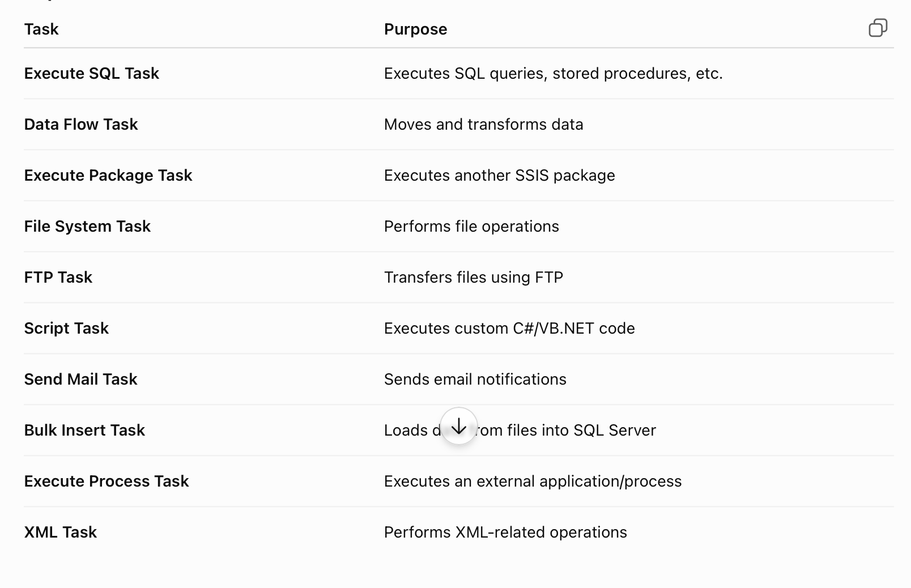
3. Tasks

Slide 15
4. Containers
A Container is used to group multiple tasks and control their execution.
Types of Containers
1. Sequence Container
Groups related tasks into a logical unit.
Example :
Sequence Container
├── Extract Data
├── Transform Data
└── Load Data
NOTE : Useful when several tasks belong to the same process.

Slide 16
4. Containers
2. For Loop Container
Repeats tasks until a specified condition becomes false.
Similar to:
for(initialization; condition; increment)
Example: Process files numbered from 1 to 10.
3. Foreach Loop Container
Repeats tasks for each item in a collection.
Folder
├── Sales.csv
├── Customer.csv
└── Product.csv
Foreach Loop can process each file one by one.

Slide 17
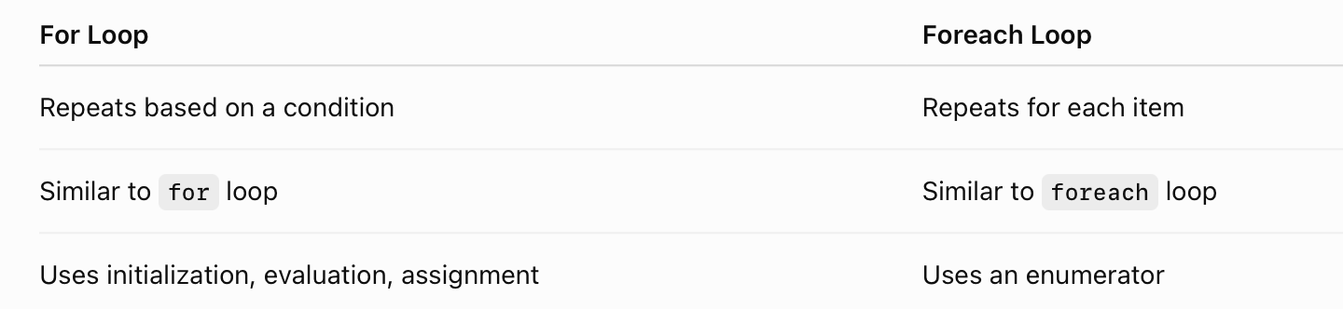
4. Containers

Slide 18
5. Precedence Constraints
Precedence Constraints determine the order in which tasks or containers execute.
They connect tasks in the Control Flow.
Extract Data
↓
Transform Data
↓
Load Data
Types of Precedence Constraints :
1. Success
2. Failure
3. Completion

Slide 19
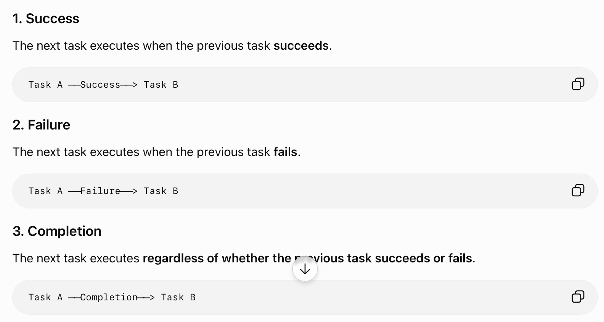
Types

Slide 20
6. Expression-Based Precedence Constraints
A precedence constraint can also use an expression to determine whether the next task should execute.
For example:
@RowCount > 1000
The connected task executes only when the expression evaluates to TRUE.
Evaluation Options
SSIS supports:
Constraint
Expression
Expression and Constraint
Expression or Constraint

Slide 21
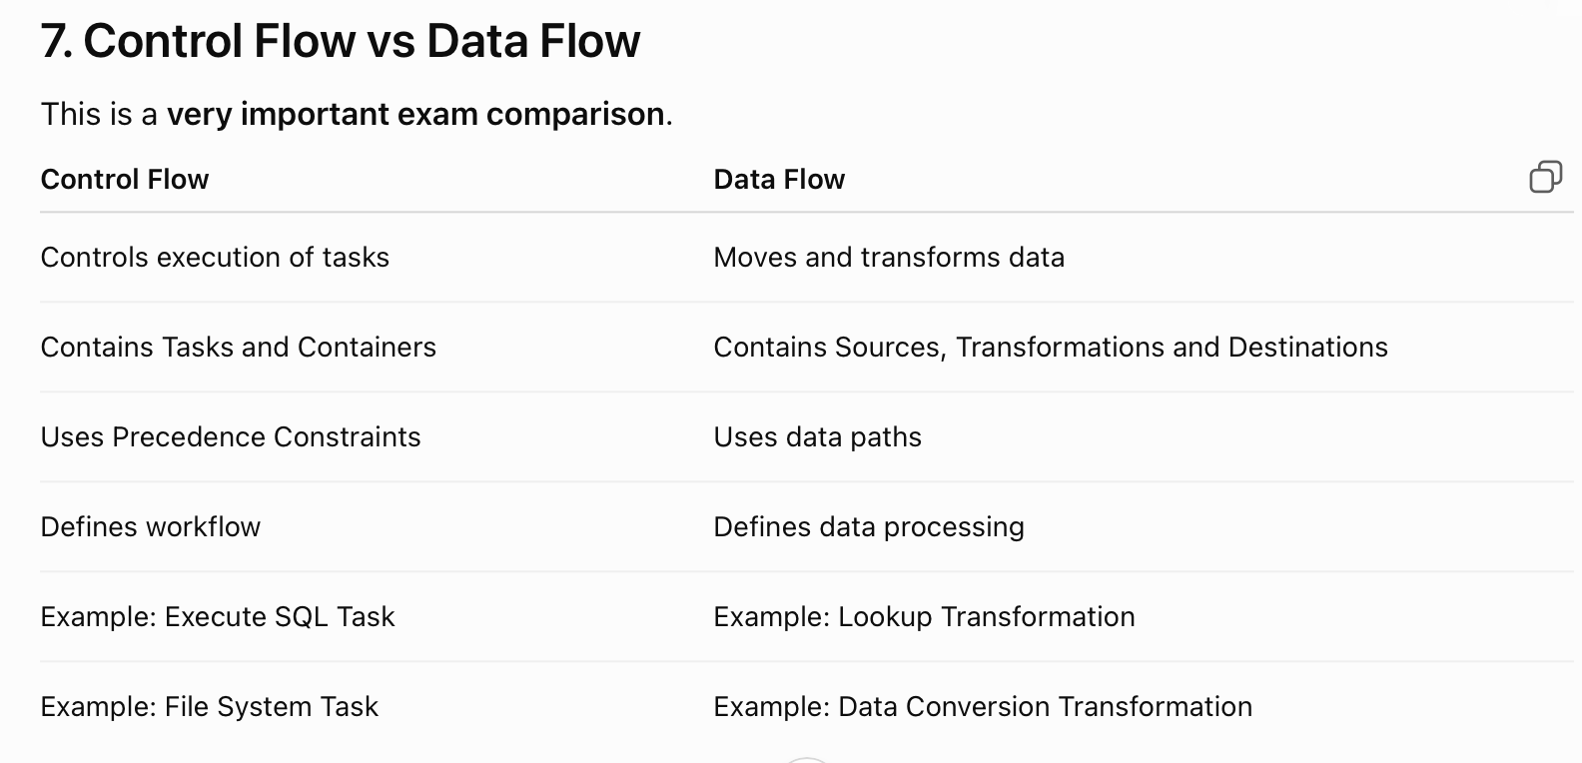

Slide 22
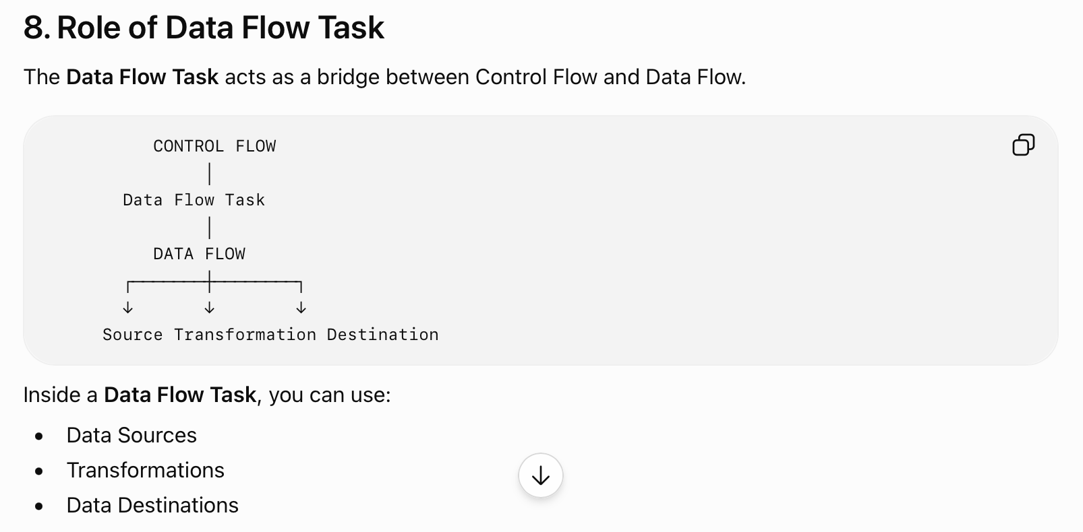
Example :
Flat File Source
↓
Data Conversion
↓
Lookup
↓
OLE DB Destination

Slide 23
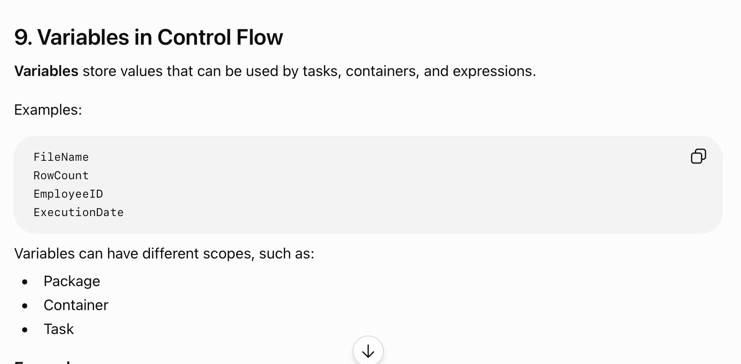
Example
A variable can store the number of rows processed:
@RowCount = 5000
Then a precedence constraint can use:
@RowCount > 1000

Slide 24
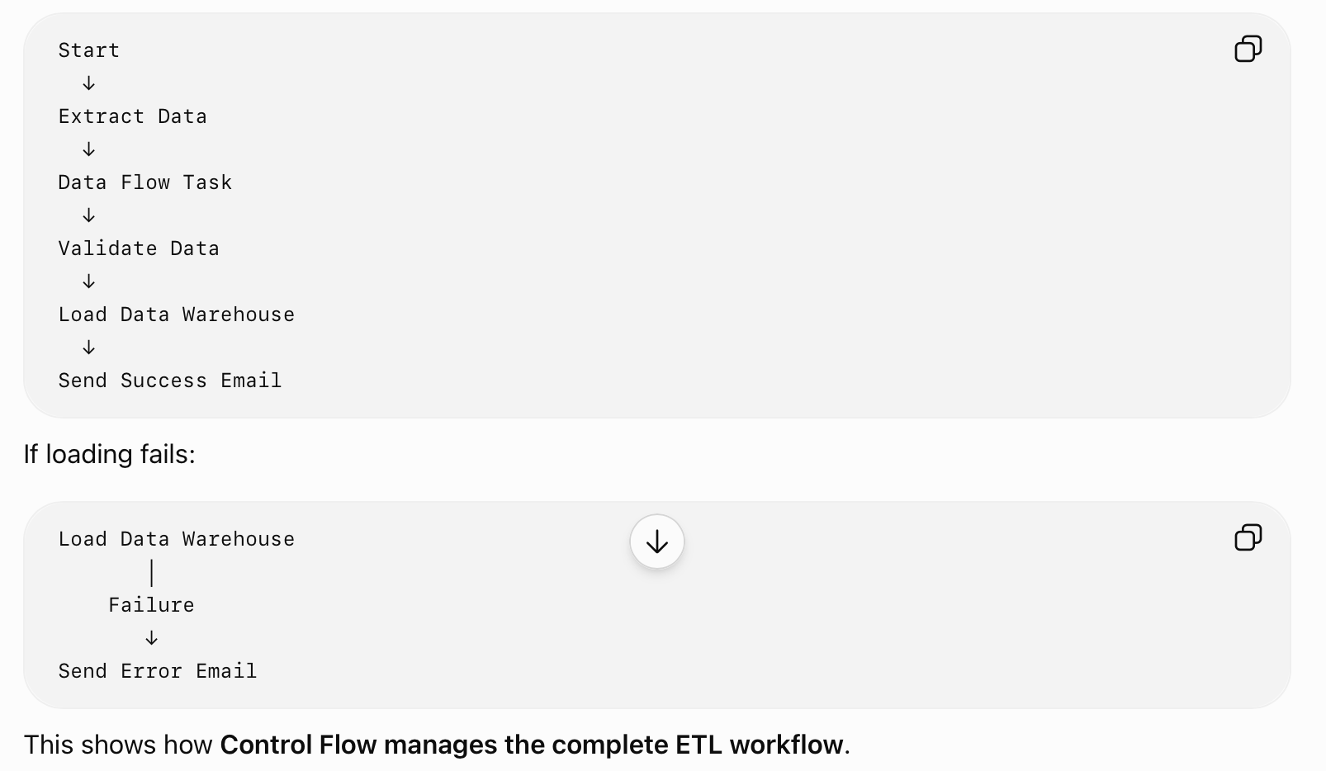

Slide 25
Derived Column Transformation in SSIS
BI

Slide 26
Derived Column Transformation in SSIS
Derived Column Transformation in SSIS is used to create a new column or modify an existing column by using expressions.
It can perform calculations, string operations, conversions, and conditional logic on incoming data.
Simple Definition
Derived Column Transformation creates or modifies columns using SSIS expressions.

Slide 27
Purpose of Derived Column Transformation
It is commonly used to:
Create new columns
Modify existing columns
Perform calculations
Concatenate strings
Apply conditional logic
Manipulate dates
Handle NULL values
Perform simple data cleansing

Slide 28
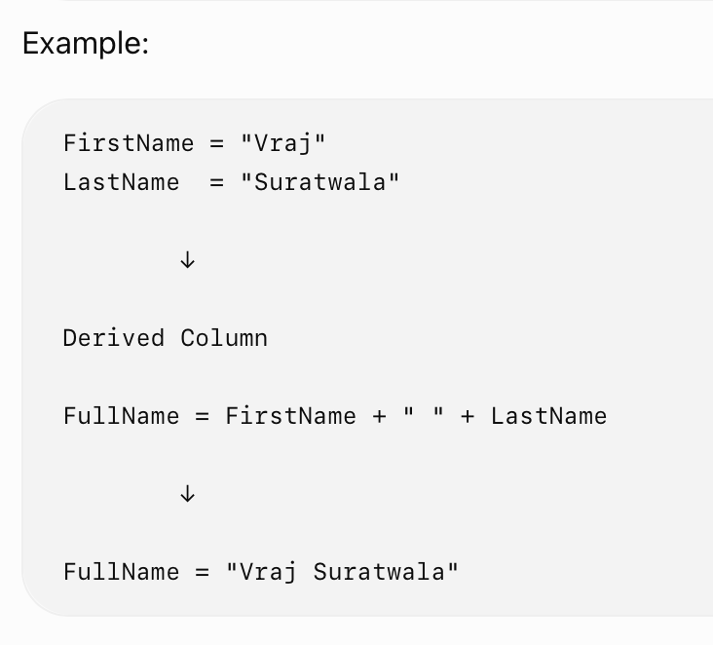
Working
Source
↓
Derived Column Transformation
↓
Destination

Slide 29
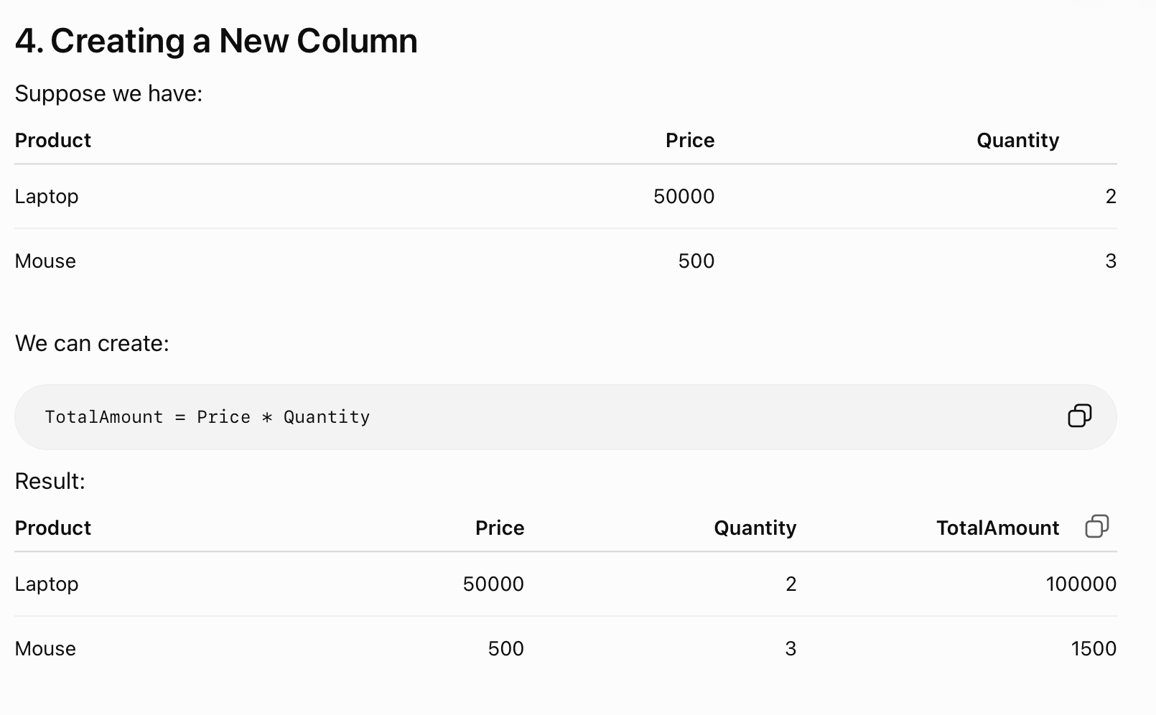

Slide 30
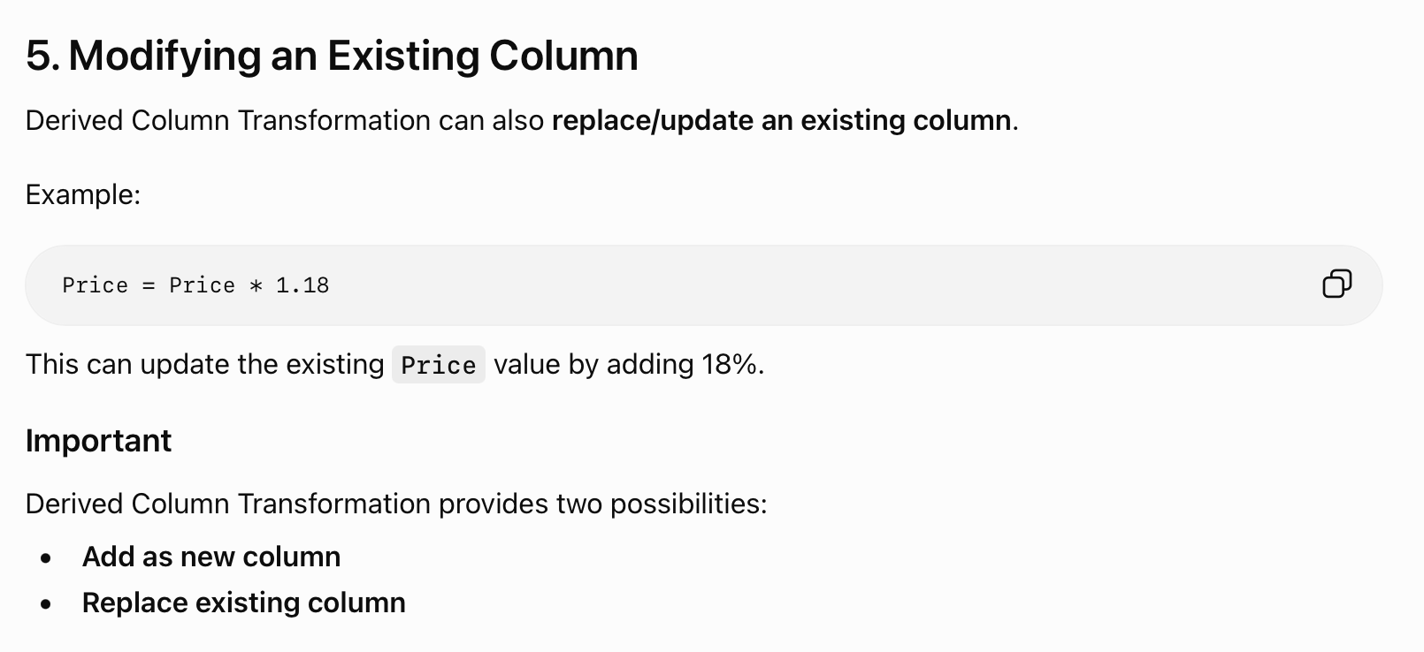

Slide 31
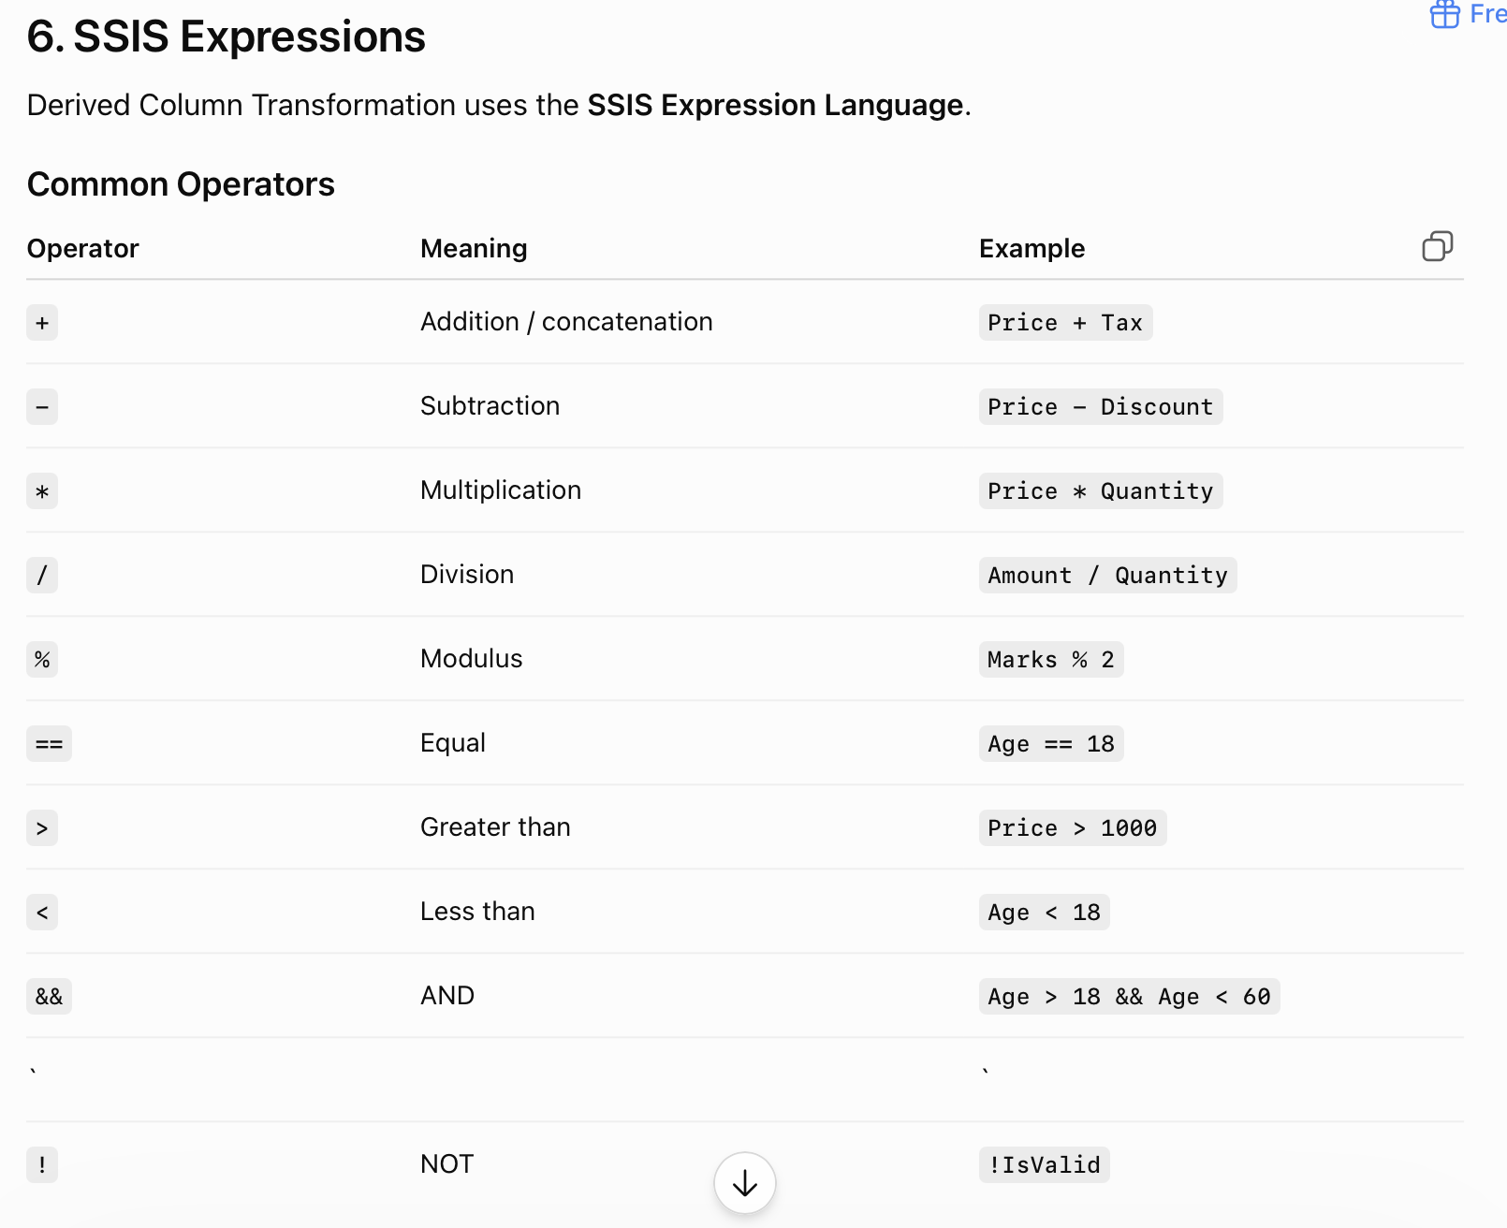

Slide 32
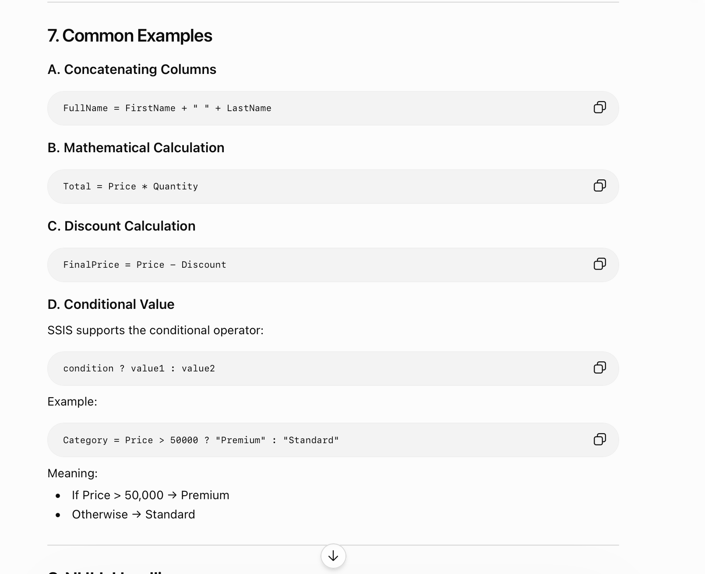

Slide 33
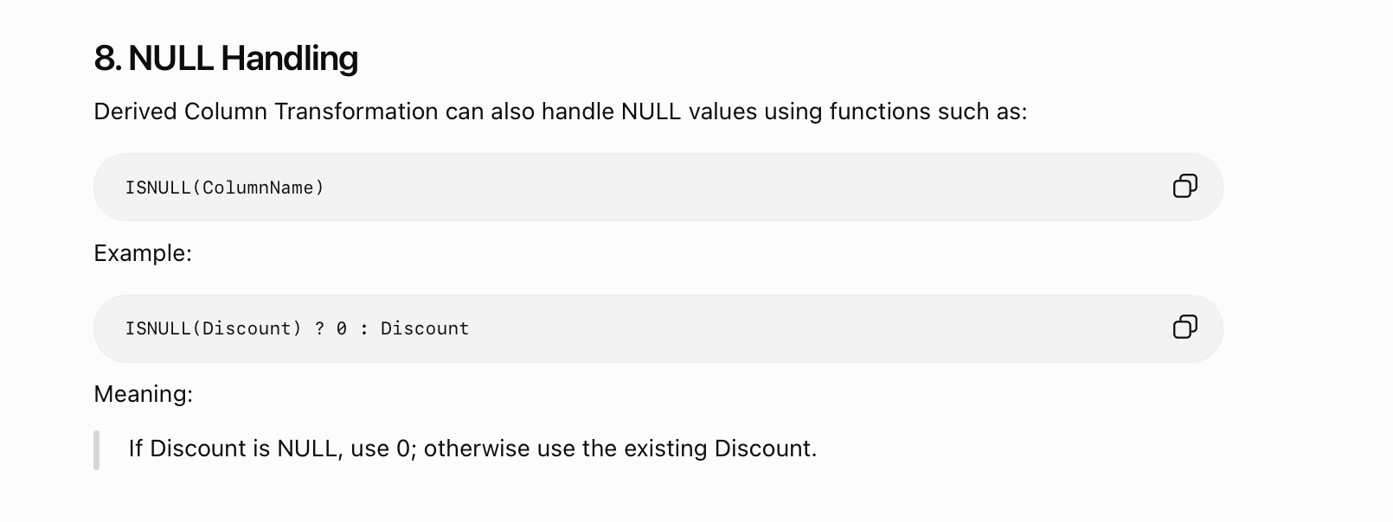

Slide 34
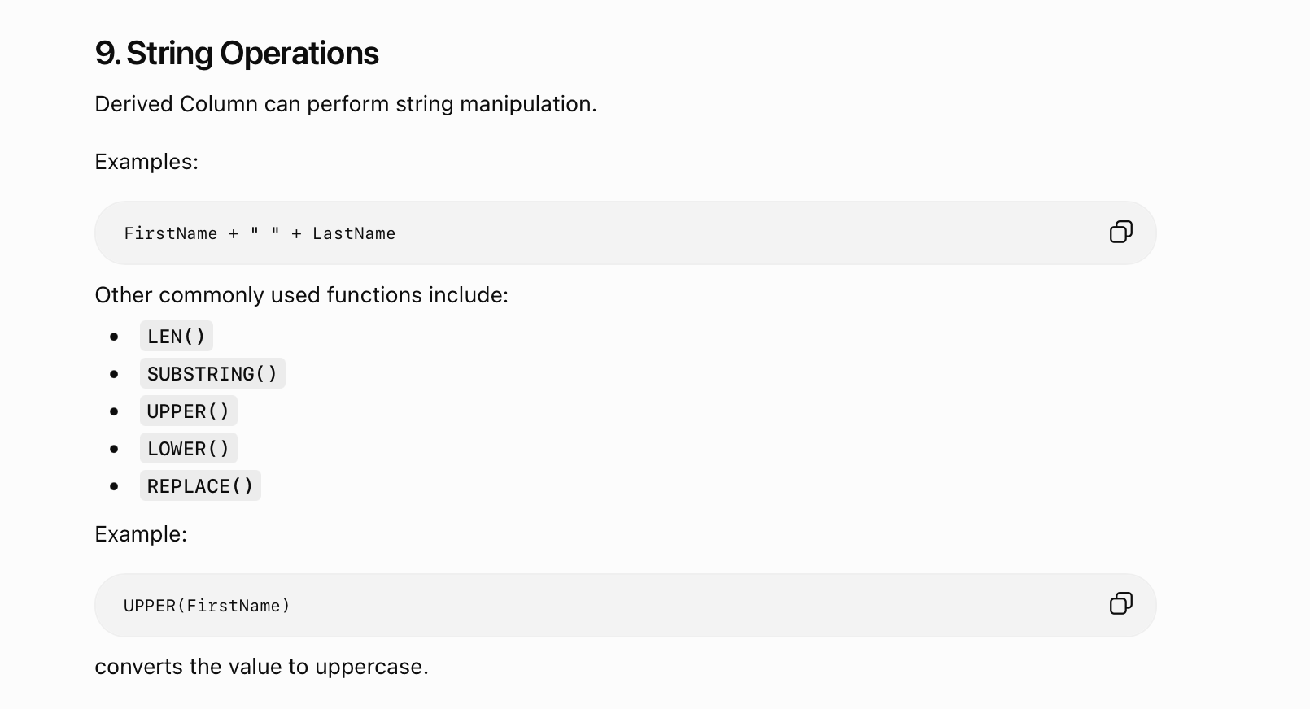

Slide 35
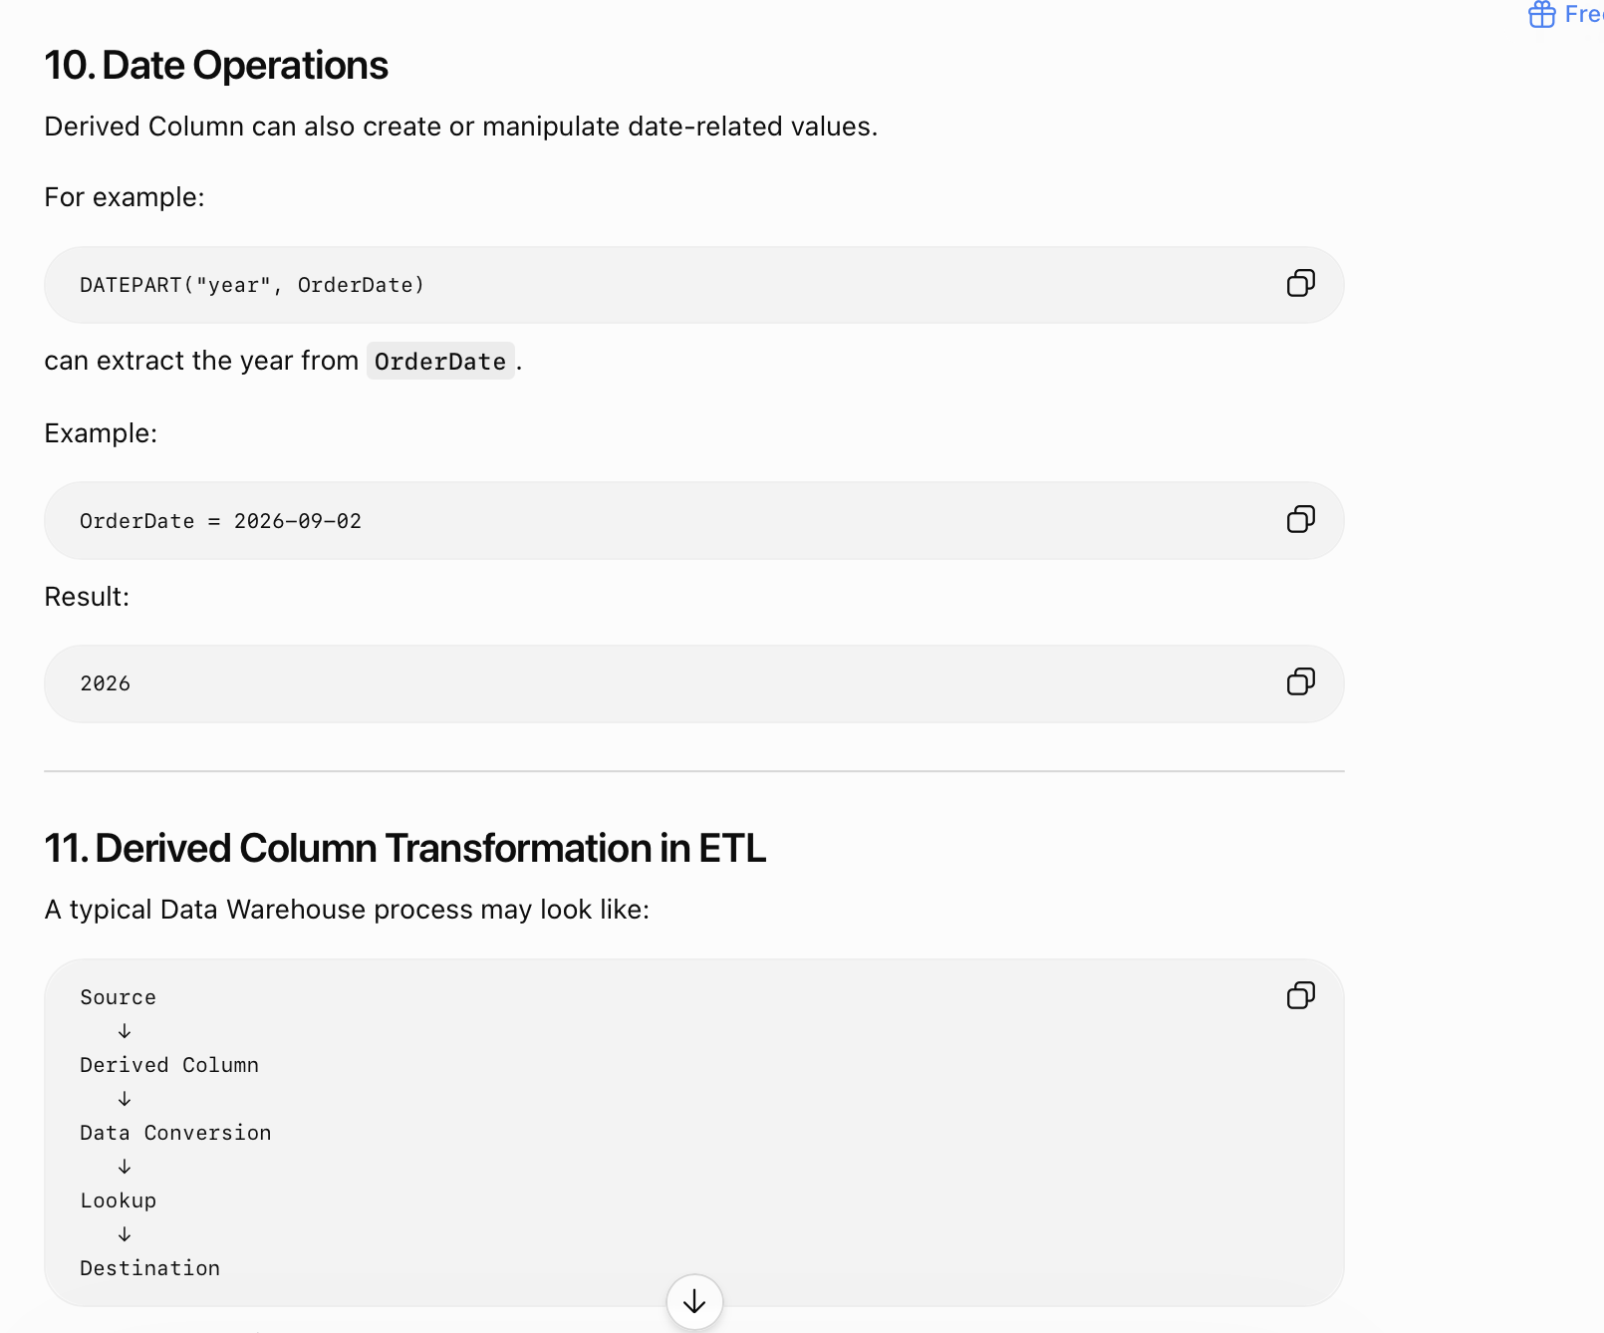

Slide 36
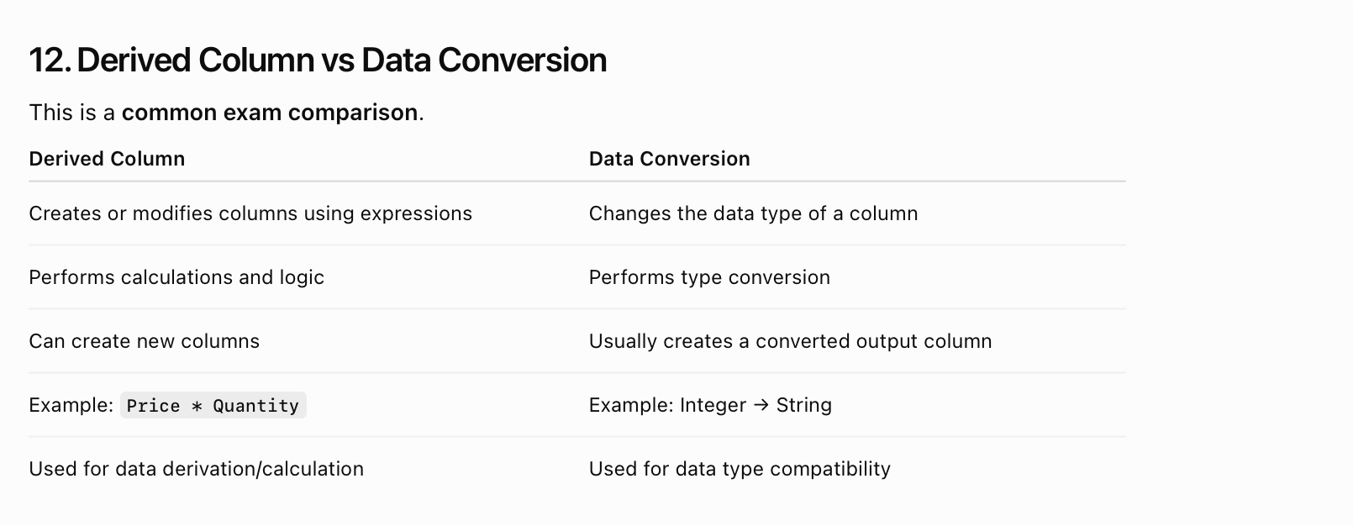

Slide 37
Different Transformation
BI

Slide 38
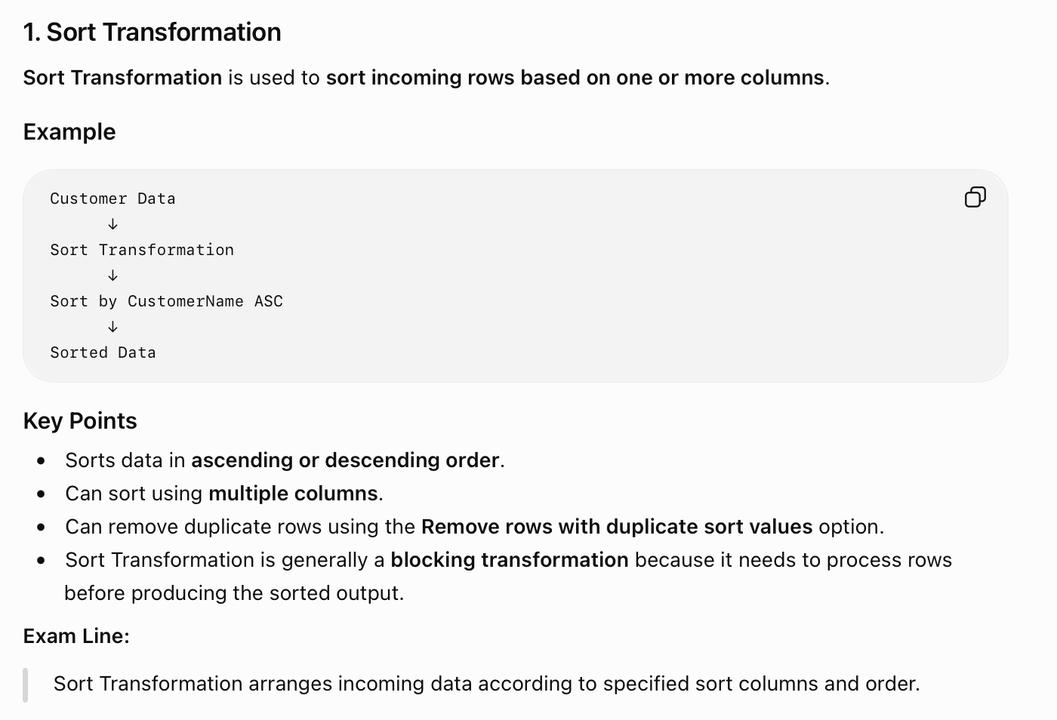

Slide 39
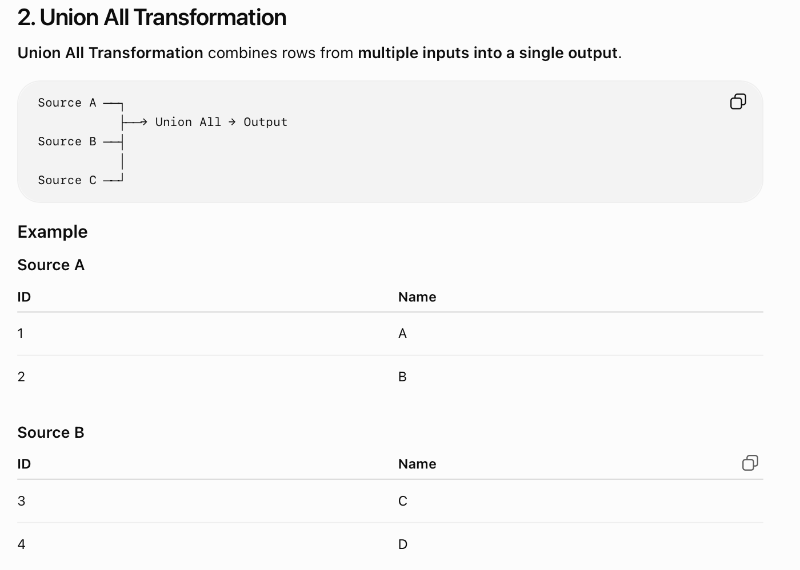
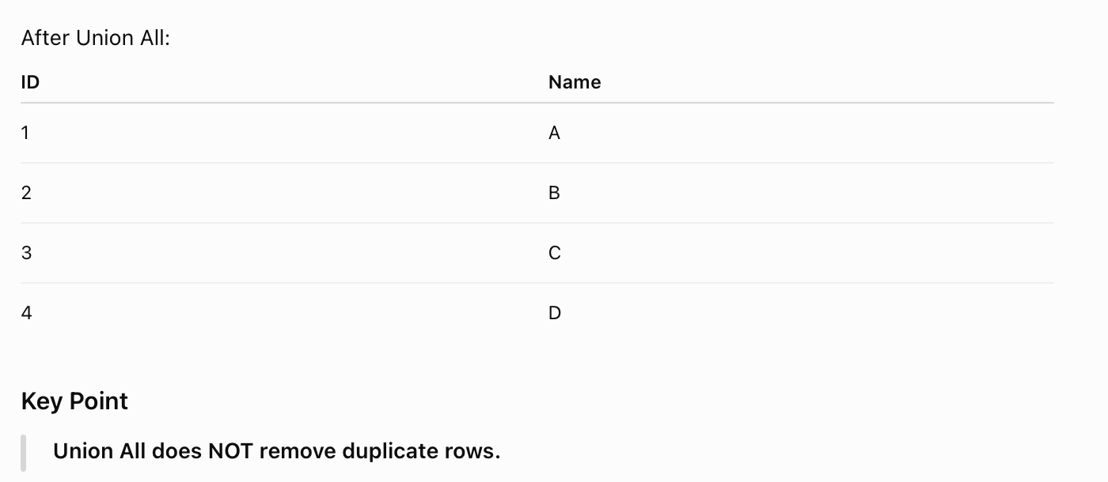

Slide 40
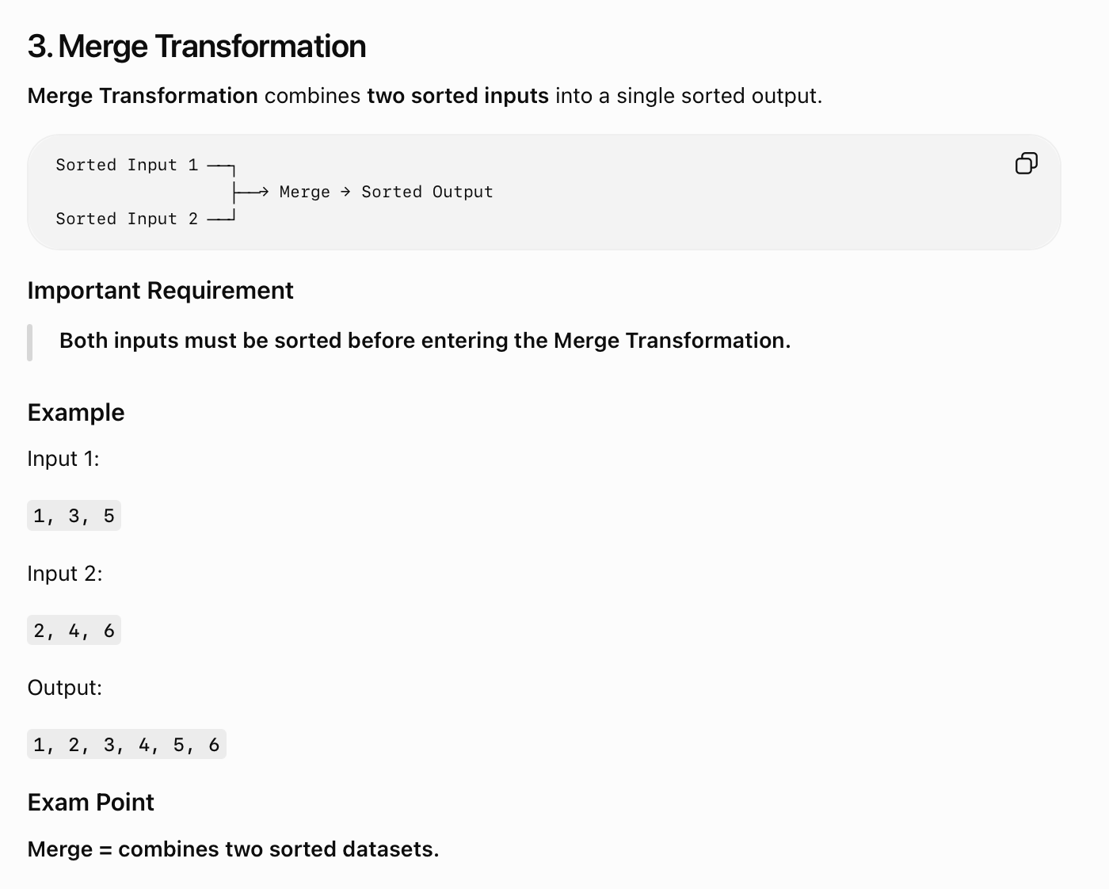

Slide 41
Merge
SSIS is able to take sorted data from more than one OLE DB data source and merge them into one table which can then be sent to an OLE DB destination. This 'Merge Join' transformation works in a similar way to a SQL join by specifying a 'join key' relationship.
works in a similar way to a SQL join by specifying a 'join key' relationship.

Slide 42
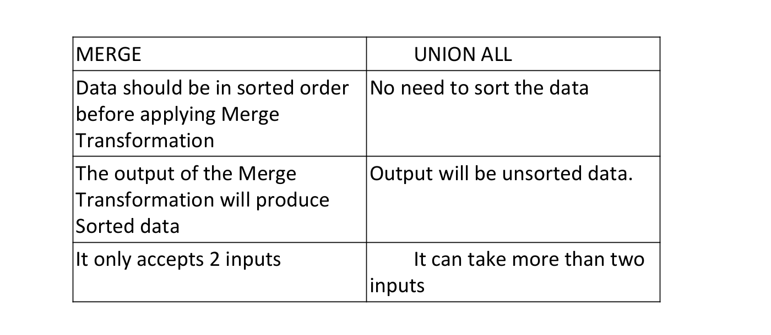
Comparision

Slide 43
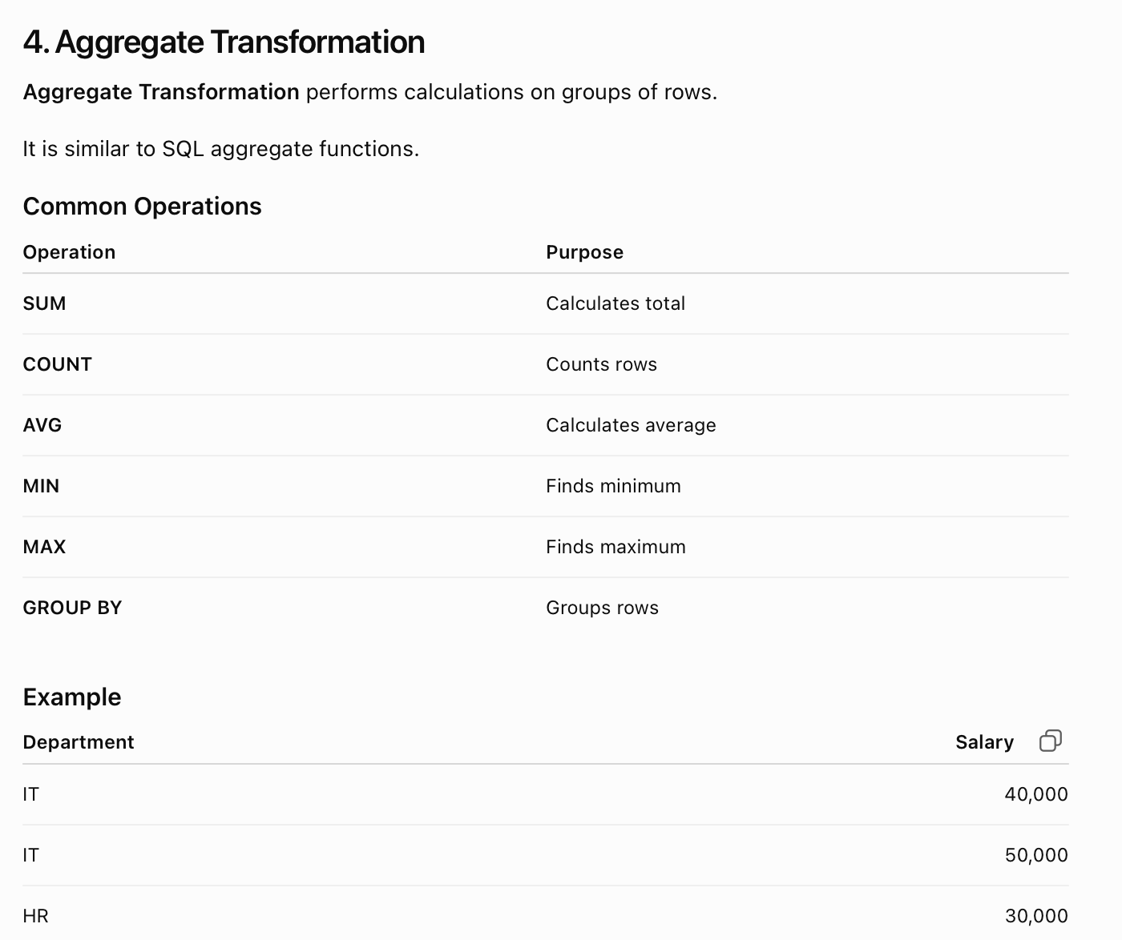

Slide 44
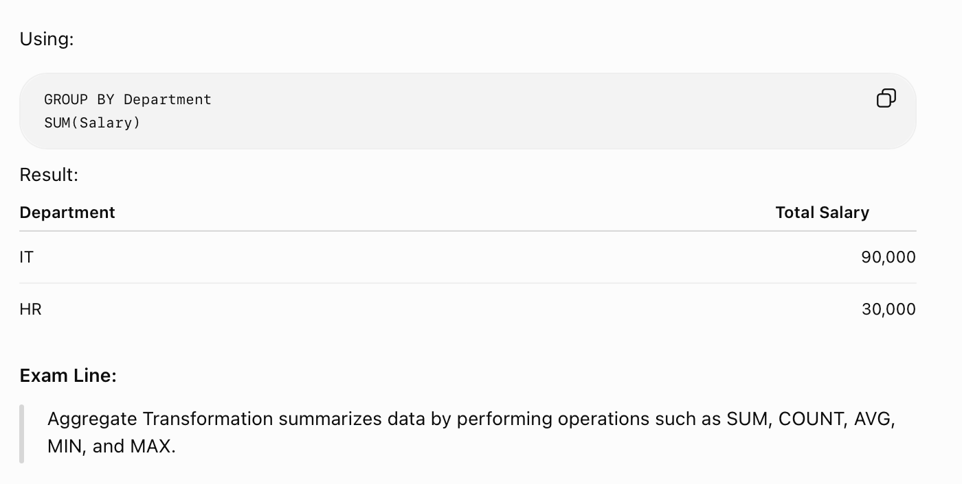
Cont...

Slide 45
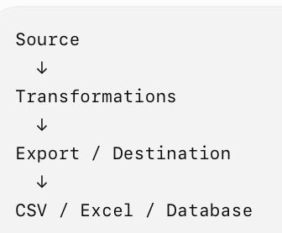
5. Export Transformation
If your syllabus specifically mentions Export Transformation, note that SSIS commonly uses destination components/tasks such as Flat File Destination, Excel Destination, OLE DB Destination, etc. for exporting data. There is not a standard built-in SSIS component officially named simply "Export Transformation."
Purpose
Exporting means transferring processed data from SSIS to an external destination such as:
CSV / Flat File
Excel
SQL Server
Other database systems

Slide 46
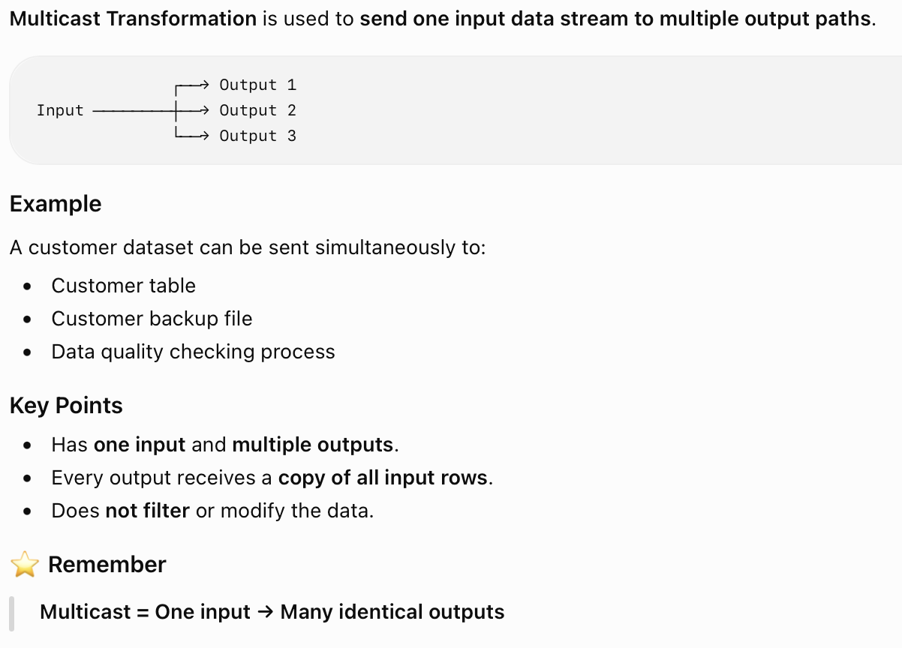
6. Multicast Transformation

Slide 47
7. Merge Join Transformation
Merge Join Transformation combines rows from two sorted inputs based on one or more matching columns.
It is similar to a SQL JOIN.
Customer ──→ Sorted ──┐
├──→ Merge Join
Orders ─────→ Sorted ─┘
Important Requirement
Both input datasets must be sorted before entering the Merge Join.
FOUR TYPES OF MERGE JOIN :
1. INNER JOIN
2. LEFT OUTER JOIN
3. RIGHT OUTER JOIN
4. FULL OUTER JOIN

Slide 48
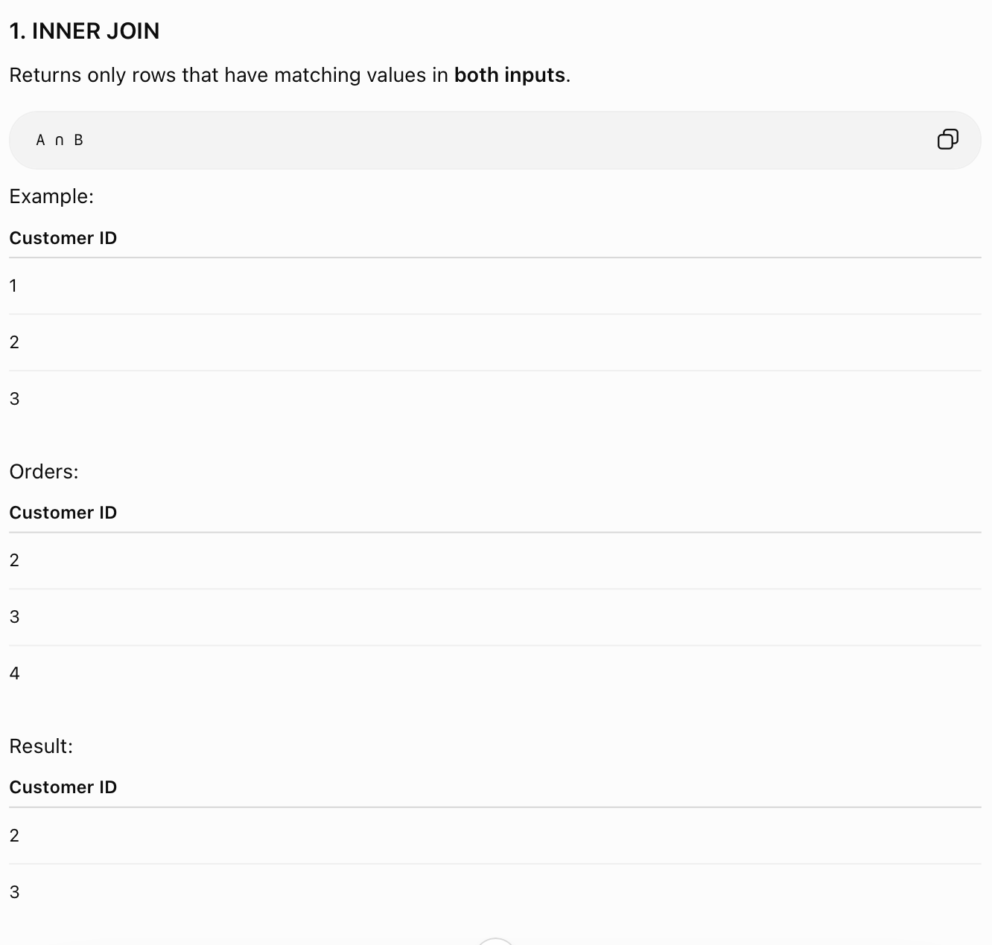

Slide 49
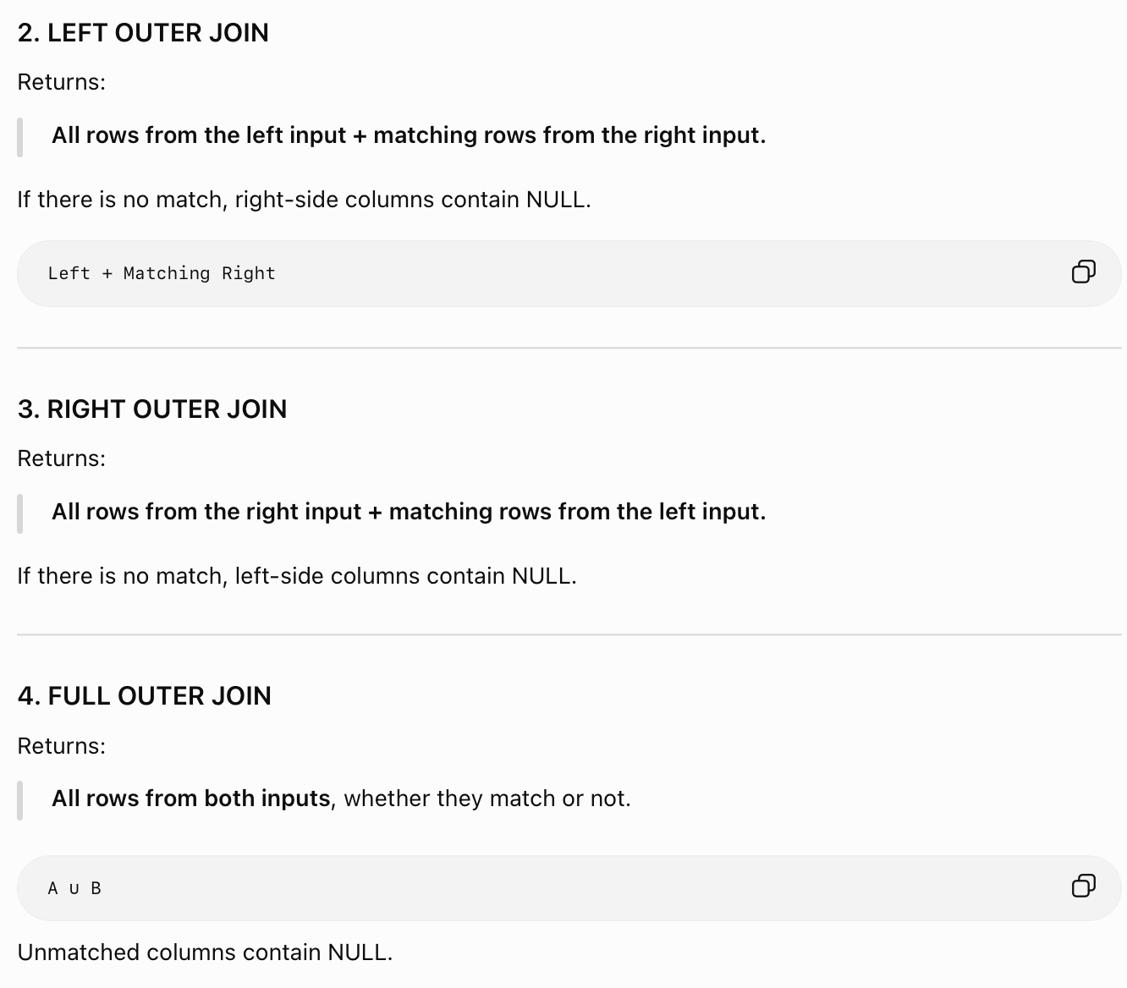

Slide 50
8. Important Column Transformation
mportant Column Transformation
The Important Column Transformation is used to mark selected columns as important or not important for downstream processing.
It is particularly useful when working with data mining / model training scenarios, where certain columns are identified as important for analysis.
Key Idea
Input
↓
Important Column
↓
Selected columns marked as Important
Important Column Transformation identifies columns that should be treated as important for downstream processing.
Derived Column → creates/modifies values
Important Column → identifies important columns

Slide 51
Event Handlers Delete-Update Operatiosn
BI

Slide 52
Introduction
Event Handlers in SSIS are used to respond to events that occur during package execution.
They allow you to execute additional tasks when a particular event occurs.
Example
Package Execution
↓
Error
↓
Event Handler
↓
Send Error Email

Slide 53
Common Events
Common Events
OnError
OnWarning
OnTaskFailed
OnPostExecute
OnPreExecute
OnInformation

Slide 54
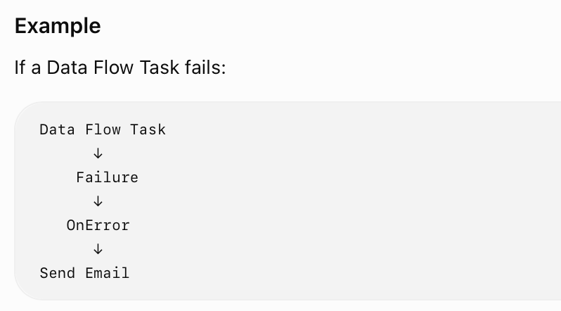
Example

Slide 55
Delete-Update Operations
Delete and Update operations are commonly required when loading data into a Data Warehouse or database.
They are generally implemented using components such as:
OLE DB Command
Conditional Split
Lookup
Execute SQL Task
Data Flow logic

Slide 56
Update Operations
Used to modify existing records.
Example:
Employee ID = 101
Salary = 40,000
Update:
Salary = 45,000

Slide 57
Delete Operations
Used to remove existing records.
Example:
Employee ID = 101
After delete operation:
Employee ID 101 → Removed
TYPICAL ETL LOGIC :
Source
↓
Lookup
↓
Conditional Split
├── New Record → Insert
├── Existing Record → Update
└── Delete Flag → Delete

Slide 58
Script Task
BI

Slide 59
Introduction
The Script Task supports Microsoft Visual C# and Microsoft Visual Basic languages.
You can choose which language you will use prior to clicking the Edit Script button.
Once you’ve clicked the Edit Script button, you cannot change the Script Language property.
Main task of Script Task is: the ability to read a variable value from the SSIS package into the script and
then write a message out of the Script Task.
Because the Script Task can interact with SSIS variables,

Slide 60
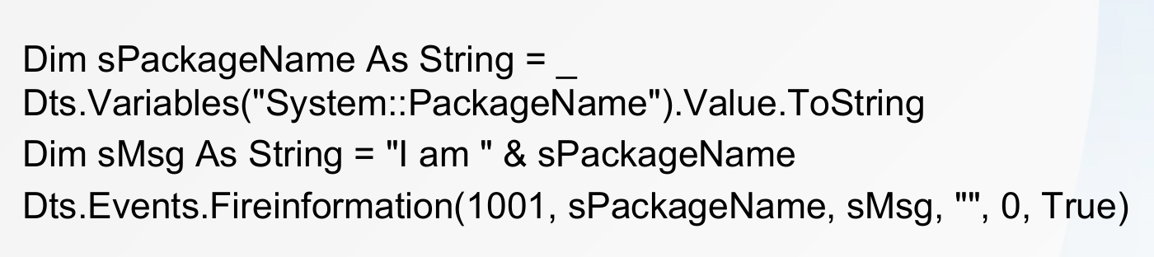
Varible Naming Convention
SSIS variables use a two-part naming convention:
<Namespace>::<VariableName>.
The selected variables are in the System namespace and contain the name of the task and package, respectively.
Click the Edit Script button to open the script editing window

Slide 61
Variable Dispenser - object
A explicit method - Provides methods for locking variables for read-only or read-write access and then retrieving them.
At one time, this was the standard way of accessing variables in scripts.
The explicit locking mechanism allows control in the Script Task to keep two processes from competing for accessing and changing a variable.

Slide 62
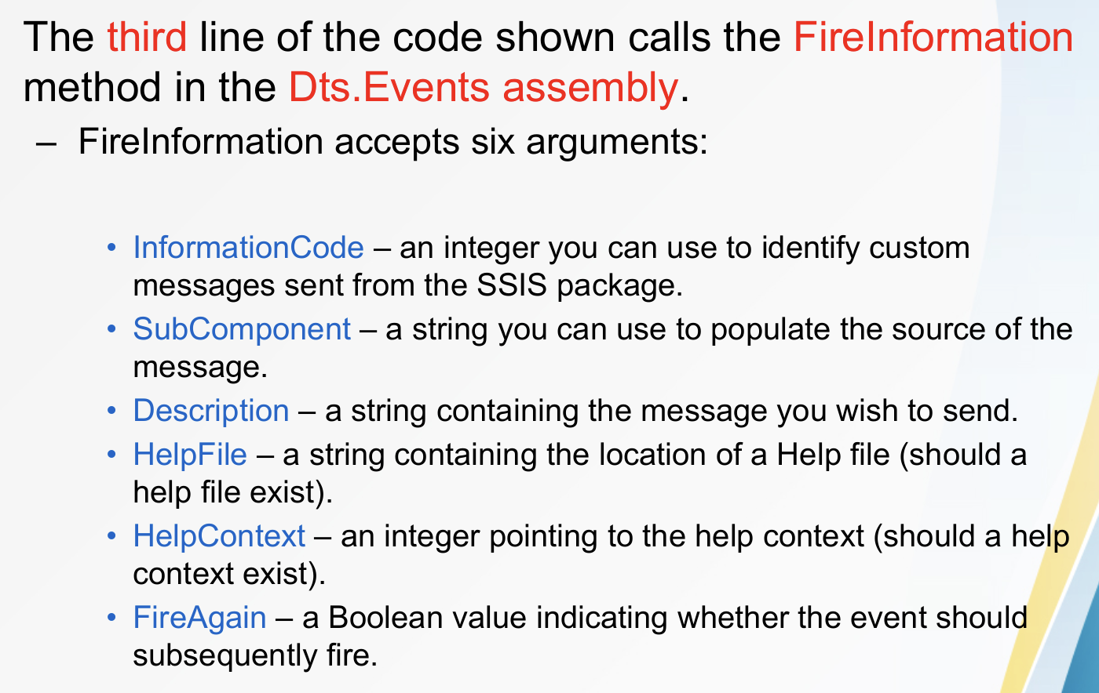
Additional

Slide 63
Usage & Flow
Example Uses
Custom validation
File manipulation
Complex calculations
Custom error handling
Calling custom APIs/services
Implementing business logic
Control Flow
↓
Script Task
↓
Custom C# / VB.NET Code

Slide 64
Lookup - Introduction
BI

Slide 65
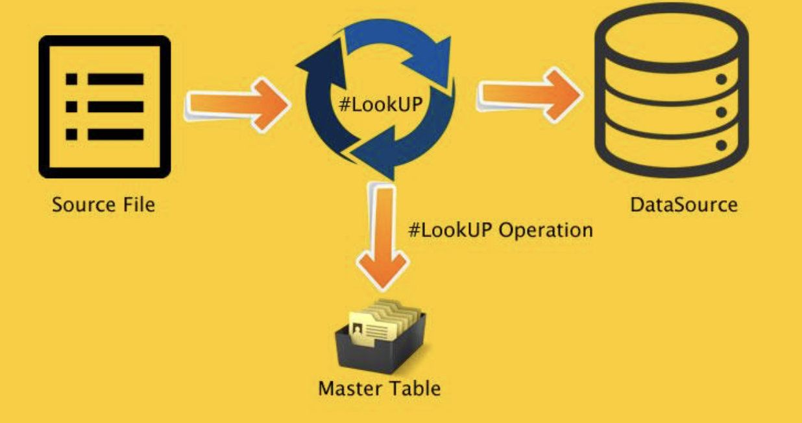
Basic Understanding Diagram

Slide 66
Definition
Lookup Transformation in SSIS is a Data Flow transformation used to find matching records in a reference dataset based on one or more columns.
In simple words:
Lookup = Search for a matching value in another table/dataset and retrieve related information.
It is commonly used in ETL and Data Warehousing for finding surrogate keys, validating records, and enriching data.

Slide 67
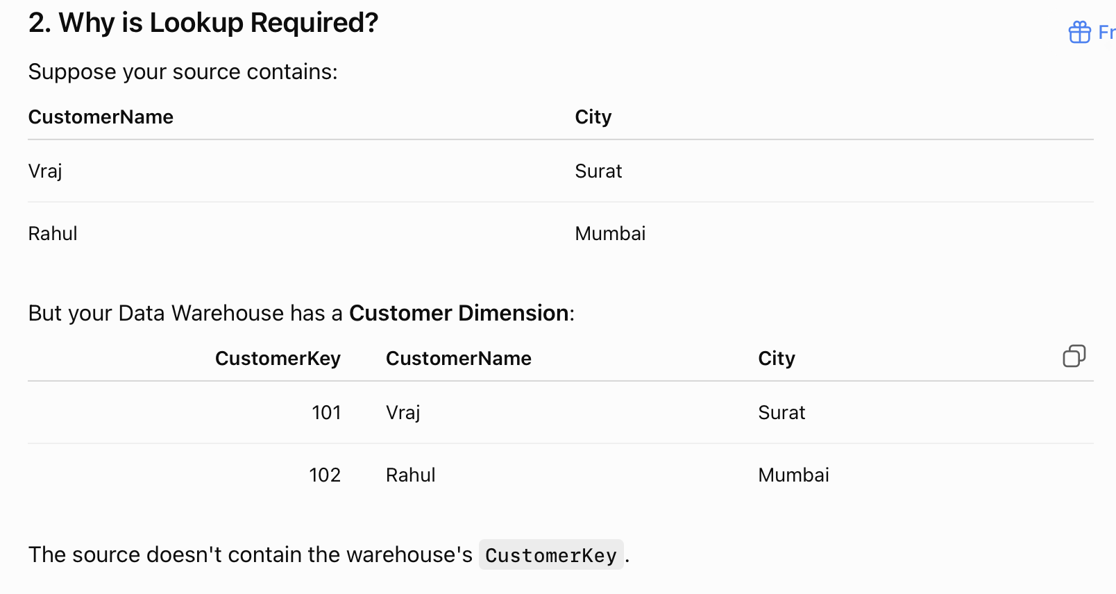

Slide 68
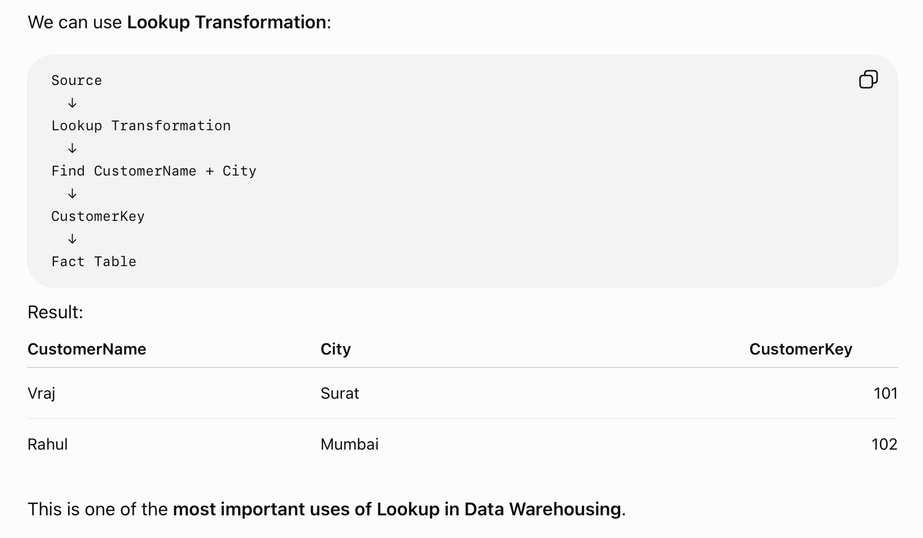

Slide 69
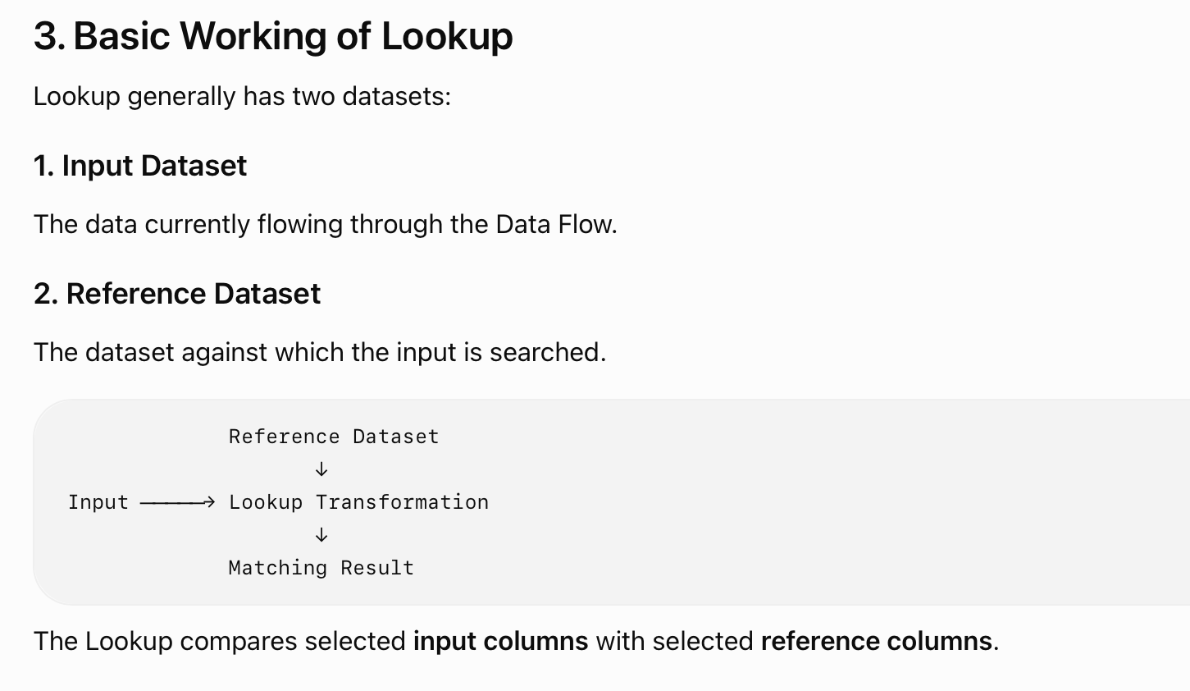

Slide 70
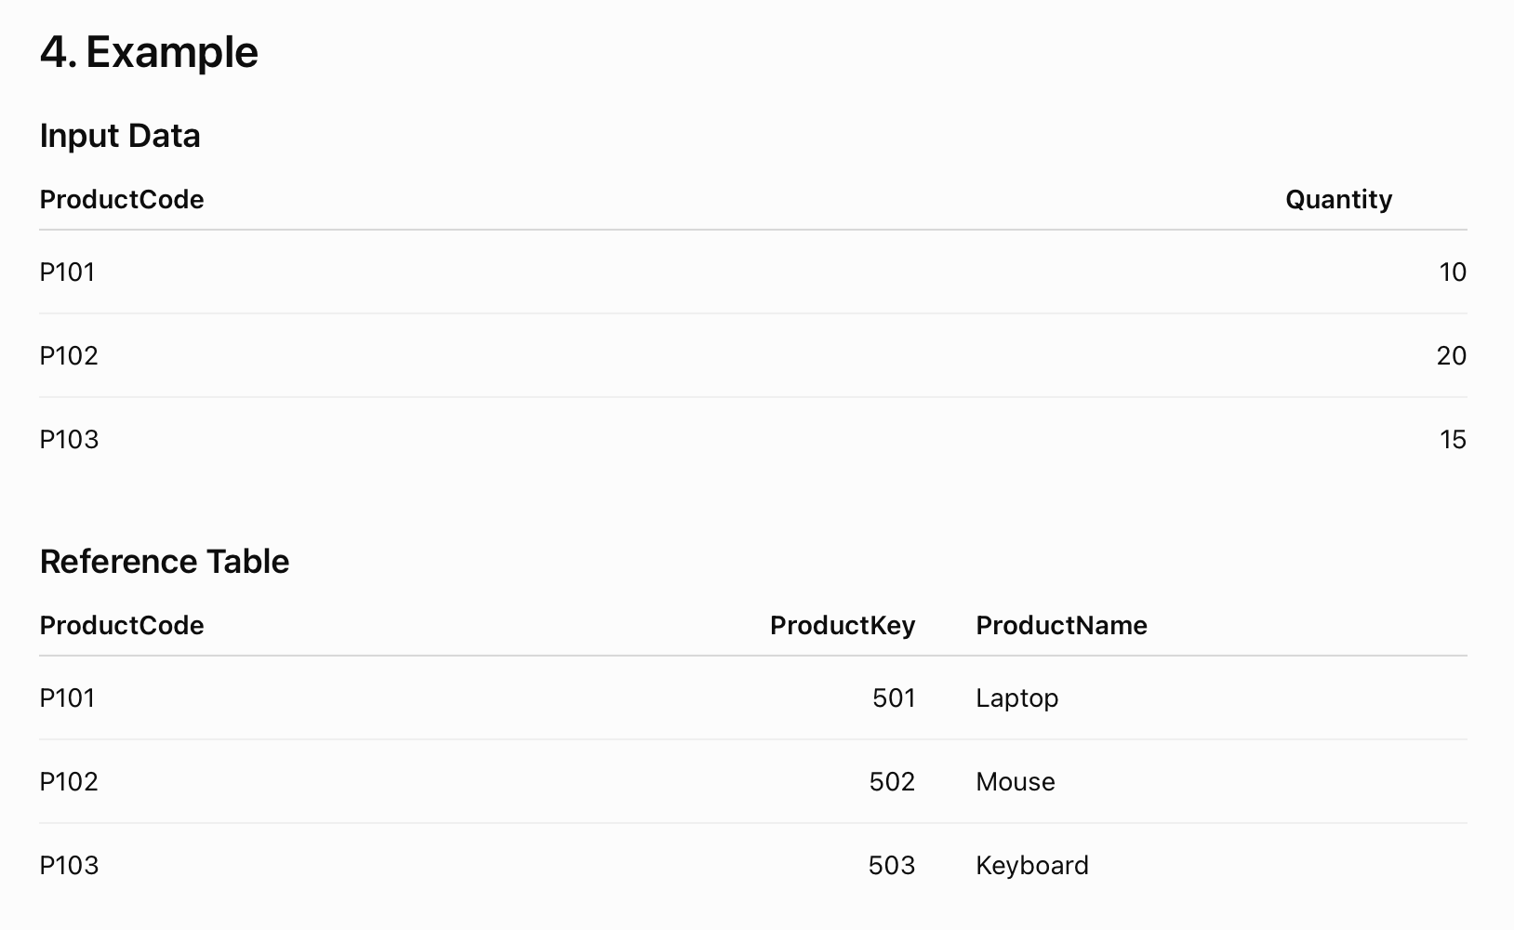

Slide 71
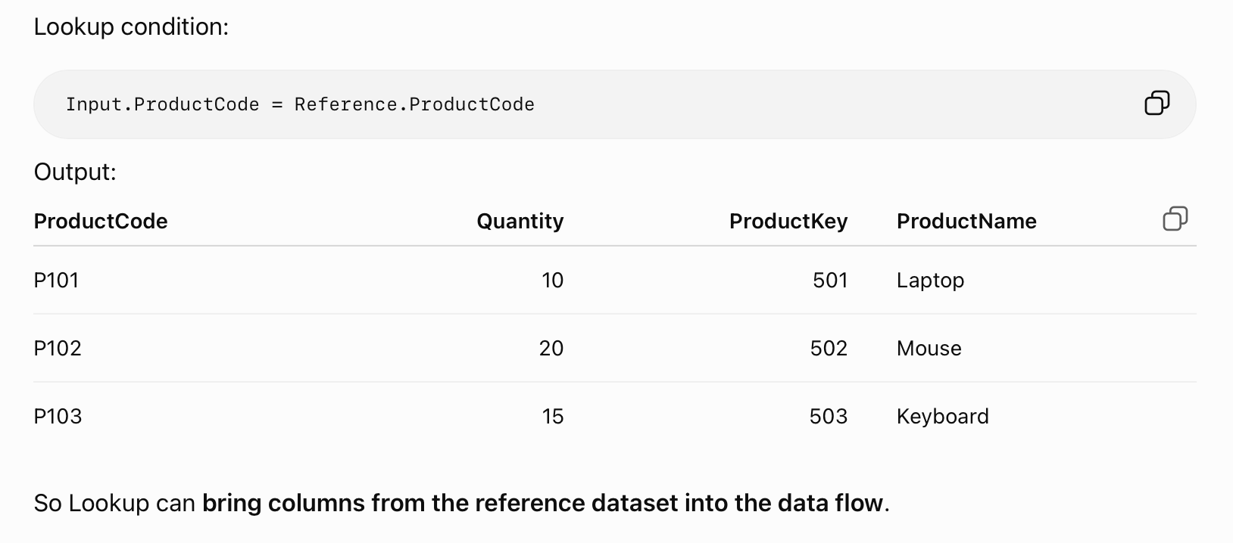

Slide 72
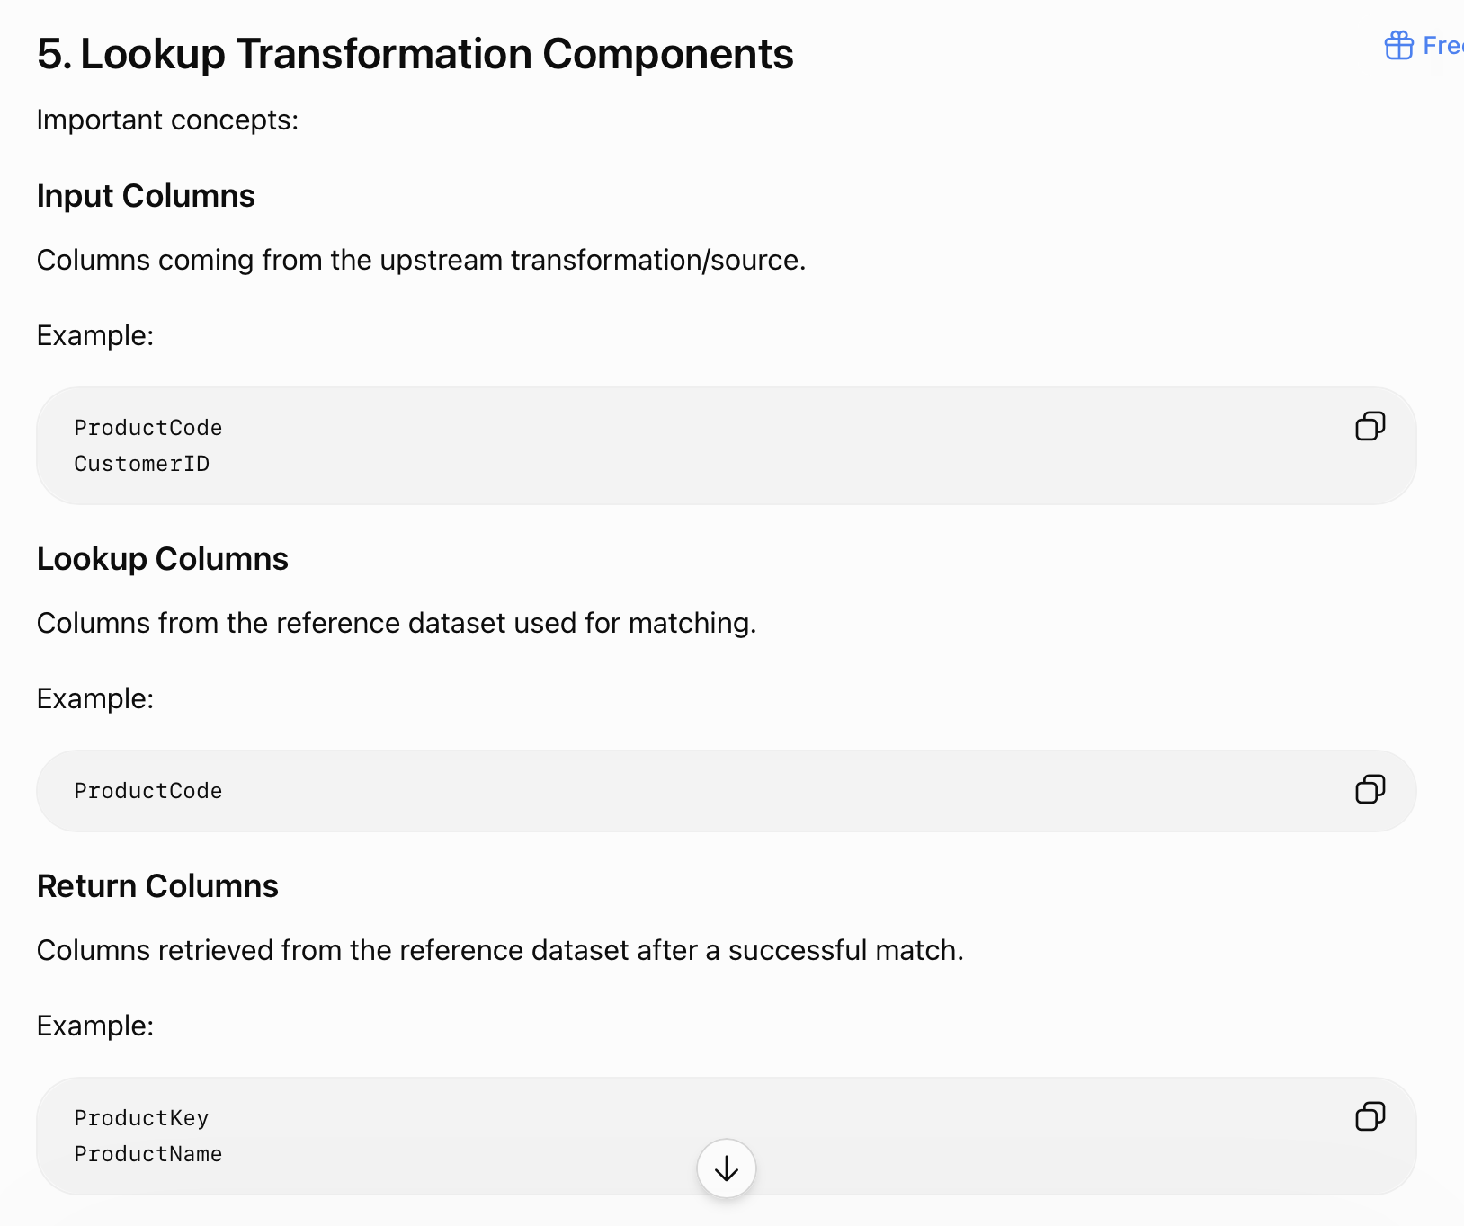

Slide 73
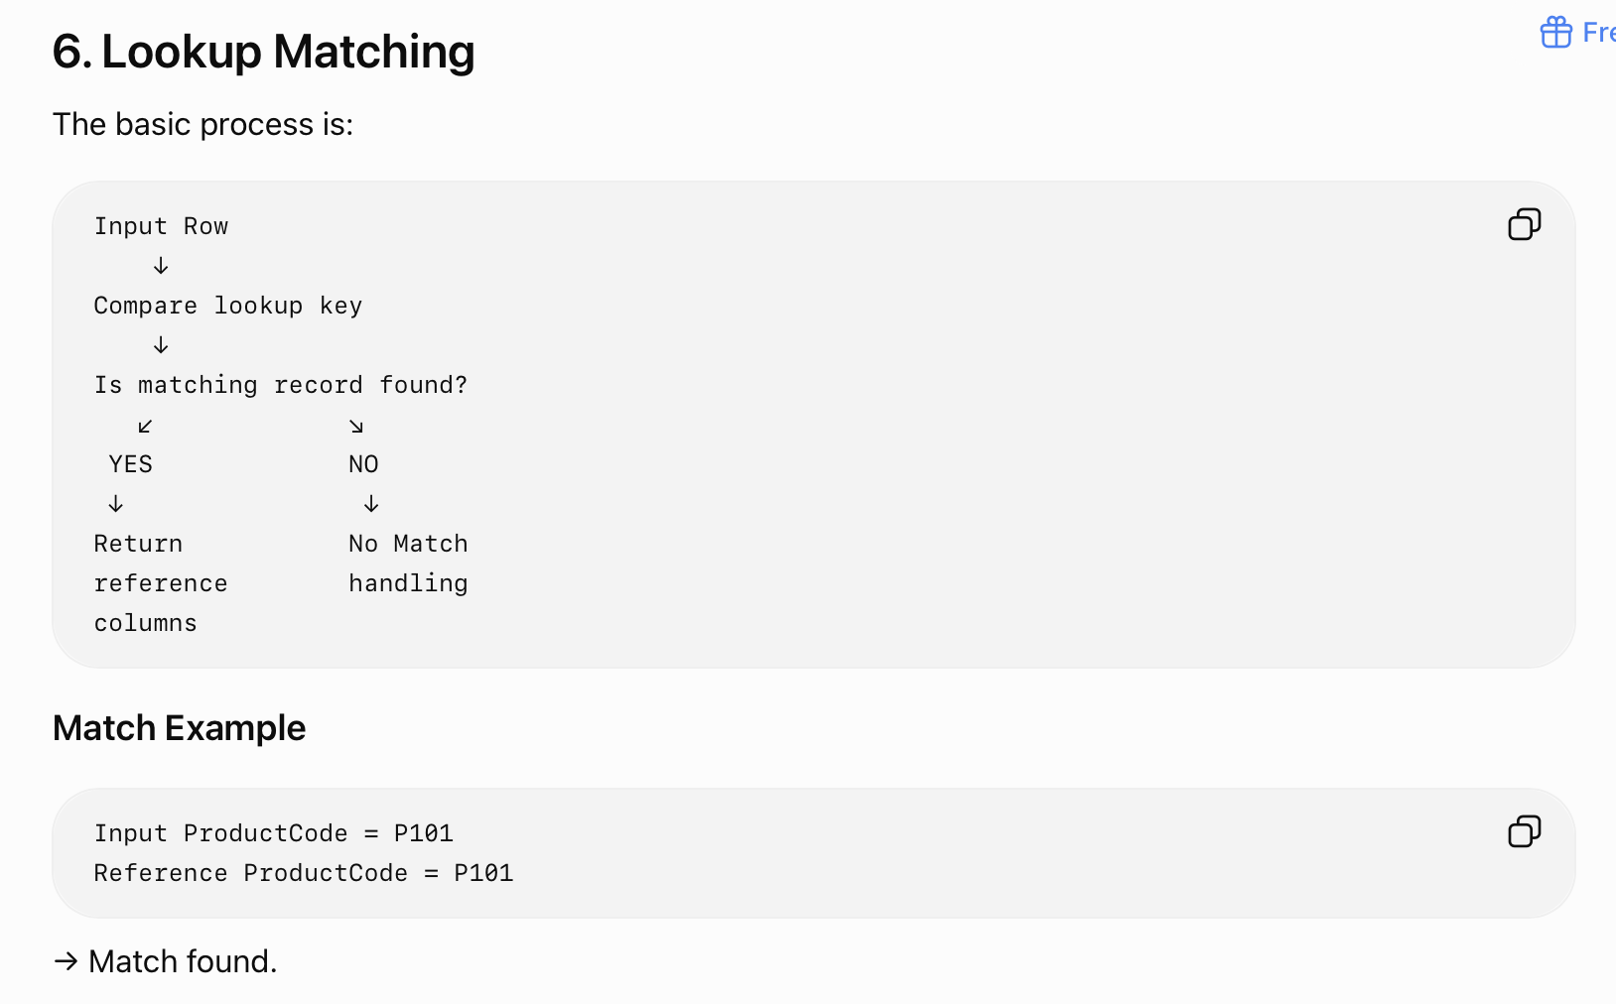
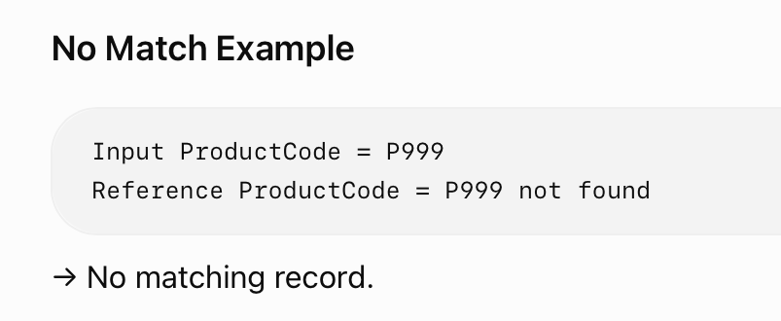

Slide 74
7. What Happens to No-Match Rows?
This is an important exam concept.
SSIS Lookup can handle rows for which no matching reference record is found.
Depending on configuration, unmatched rows can be:
Redirected to a separate output
Ignored
Handled according to the configured error/no-match behavior
A common ETL pattern is:
Lookup
├── Match Output → Continue processing
│
└── No Match Output → Insert / Error Handling

Slide 75
Example
For example, if a new customer is not found in the Customer Dimension:
Customer Source
↓
Lookup
↓
┌───┴────┐
Match No Match
↓ ↓
Fact New Customer Load Processing

Slide 76
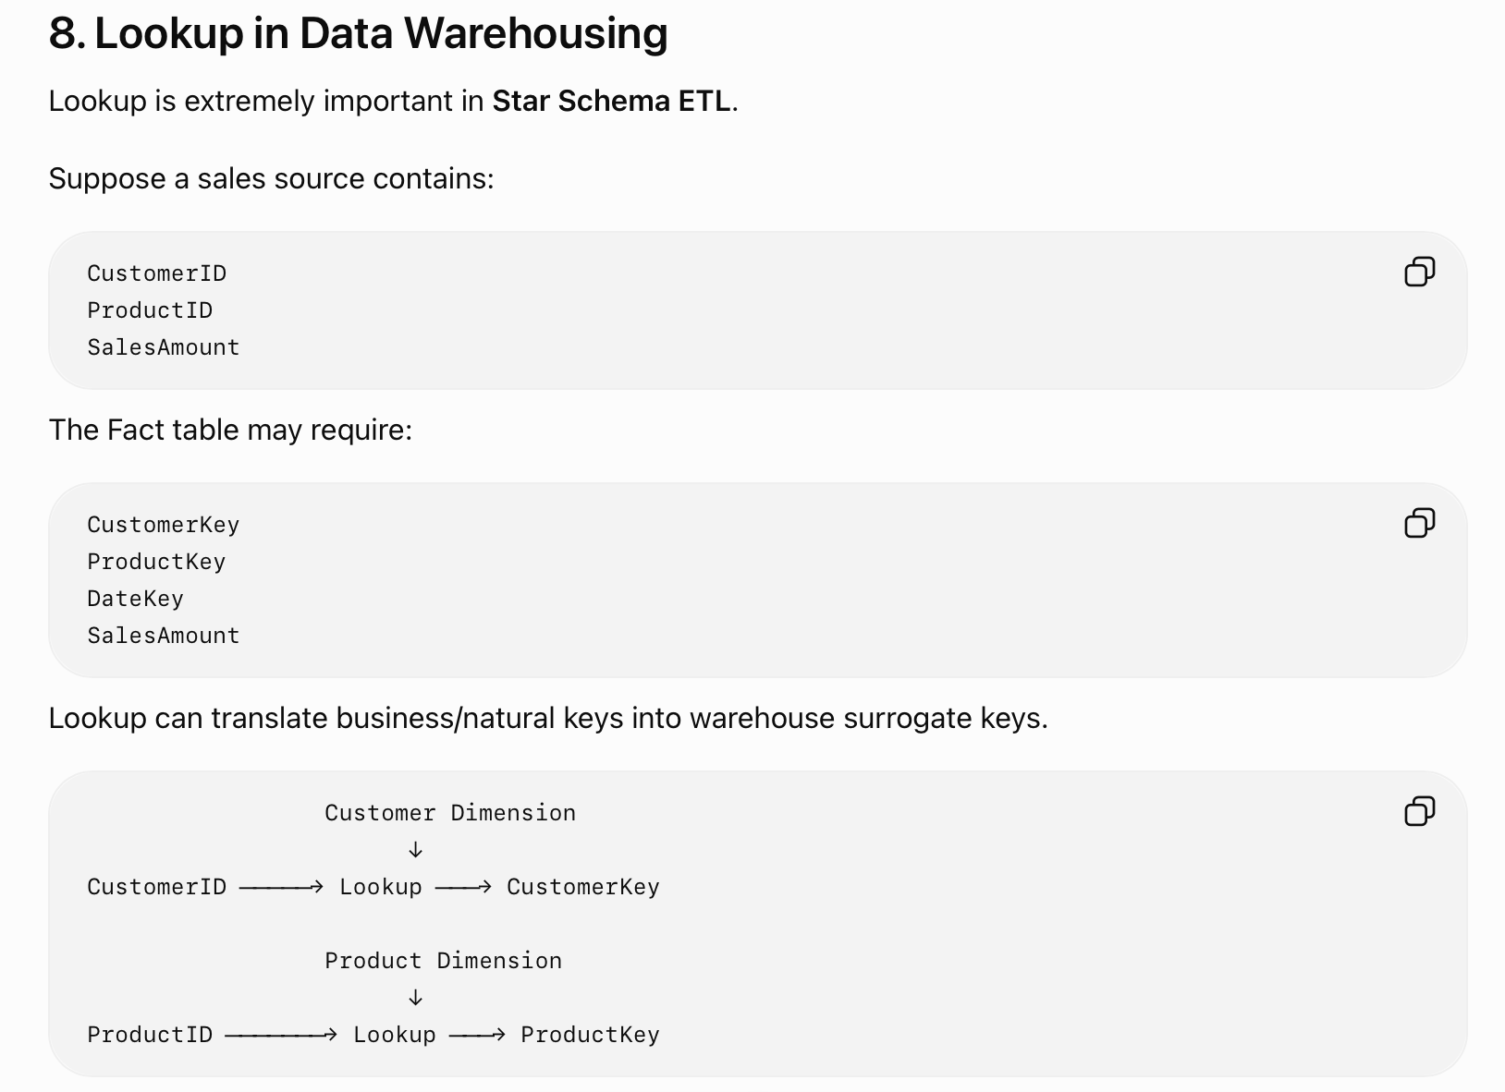

Slide 77
Lookup Caching
SSIS Lookup can use caching to improve performance.
The reference data can be stored in memory so that repeated searches can be performed faster.
Common cache modes include:
Full Cache
The complete reference dataset is loaded into memory before the Lookup starts processing.
Advantage: Fast lookup operations.
Disadvantage: Requires more memory.
Partial Cache
Only required reference data is loaded into cache as it is requested.
Advantage: Can reduce memory usage compared with full cache.

Slide 78
Lookup Caching
No Cache
The reference data is not cached by the Lookup transformation.
The reference source is queried when required.

Slide 79
IMP Properties
Connection Manager
Lookup uses a connection to access the reference data.
The reference source can commonly be a database table or query.
Join / Matching Columns
Columns used to determine whether an input row matches a reference row.
Example:
Input.CustomerID = Reference.CustomerID
Return Columns
Columns obtained from the reference dataset.
Example:
CustomerKey
CustomerName

Slide 80
Thank You
Vraj Suratwala
Department of ICT, VNSGU

